Slide 1
Service-Disabled Veteran Owned Small Business & Ethnic Minority Owned Business Small Purchase Procedure April 2017

Slide 2
Purpose & Goal
To increase ethnic minority businesses and service-disabled veteran owned small businesses (SDVOSB) participation in the procurement process by increasing their opportunities.

Slide 3
Definitions
“Ethnic minority" means African-American; Hispanic American, Asian Pacific American; Subcontinent Asian American or Native American.
SDVOSB means service-disabled military veterans who own a business.

Slide 4
Measures of Success
Success =
Ethnic minority business & SDVOSB registration in eMARS
Quotes issued to ethnic minority businesses & SDVOSB
Quotes received from ethnic minority businesses & SDVOSB
Number of contracts with ethnic minority businesses & SDVOSB
Dollars spent with ethnic minority businesses & SDVOSB

Slide 5
Background
In 2013, at the direction of the Governor’s office, OPS initiated the ethnic minority small purchase initiative to to promote increasing participation and opportunity for ethnic minority businesses.
During the 2017 regular legislative session, HB161 was enacted to promote increasing participation and opportunity for service-disabled veteran owned small businesses (SDVOSB).

Slide 6
Implementation
Agencies utilizing their Small Purchase Authority in excess of their one quote limit will solicit at least one quote from an ethnic minority vendor and from a SDVOSB. (Does not apply to construction.)
Agencies will locate ethnic minority & SDVOSB vendors via eMARS.
Agencies will document award on Request for Quote Determination & Finding (RFQ D&F).

Slide 7
Locating Ethnic Minority Vendors
There are two methods of locating ethnic minority & SDVOSB vendors in eMARS:
1. Create a RFQ and select vendors through the Vendor Rotation tab
2. VENDCMBT table search

Slide 8
Locating Ethnic Minority Vendors
Create a RFQ.
On the Vendor Rotation screen:
Enter or search for the appropriate commodity
The Append Vendor List field should be selected
In the Business Type field, type B060 for ethnic minority or B080 for SDVOSB.
In the Quantity Business Type field, enter the number of businesses desired.
Click on Load Vendor Rotation.
METHOD 1 - RFQ Process

Slide 9
Locating Vendors
1. Enter Commodity Code
2. Keep Checked
4. Enter # of businesses desired
3. Enter/select Business Type
5. Click Load Vendor Rotation

Slide 10
Locating Vendors
VENDCMBT is a table in eMARS
On the VENDCMBT table search enter B060 for ethnic minority and B080 for SDVOSB in the Business Type ID field.
Enter a commodity code in the commodity Code field
A list of Vendor/Customer numbers for businesses that have registered for those business types and commodity will return.
METHOD 2 – VENDCMBT Table Search

Slide 11
Procedure – RFQ vs. Email/Fax
Agencies may choose to complete the RFQ process through SRW & EV to complete award
OR request quotes from the vendors via email or fax & complete stand-alone award

Slide 12
PROCEDURE 1 - RFQ Process
Agencies choosing to complete the RFQ process:
Must finalize the RFQ including specifications, terms & conditions. Submit and approve at the agency level. The RFQ will post to VSS. The vendors listed on Vendor Rotation will receive an email. RFQ’s may be posted for less than 7 days.
After the RFQ closing date, enter responses using the SRW. Create a SRW for each response. If no response is received for a vendor enter No Response on the SRW.

Slide 13
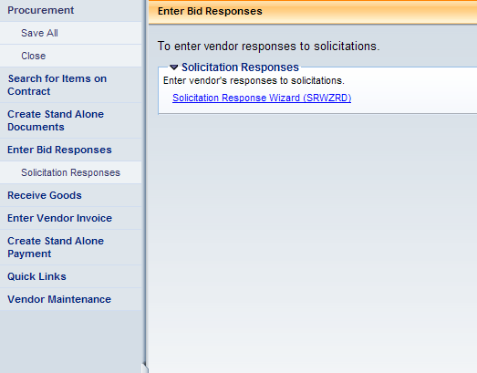
PROCEDURE 1 - Vendor Response
1. Access the Procurement workspace and click Enter Bid Response
2. Click on the Solicitation Response Wizard (SRWZRD)

Slide 14
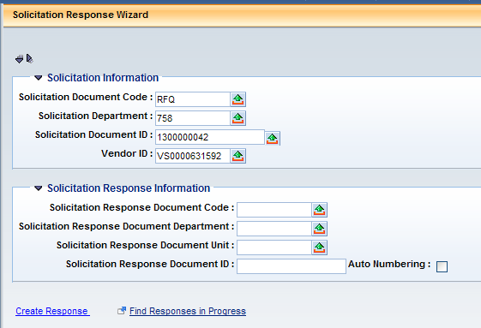
PROCEDURE 1 - Vendor Response
Required Information
Document Code
Department
Document ID
Vendor ID
Click Create Response

Slide 15
PROCEDURE 1 - Vendor Response
Complete the Response Summary Section
Required Information
Response Date
Response Time

Slide 16
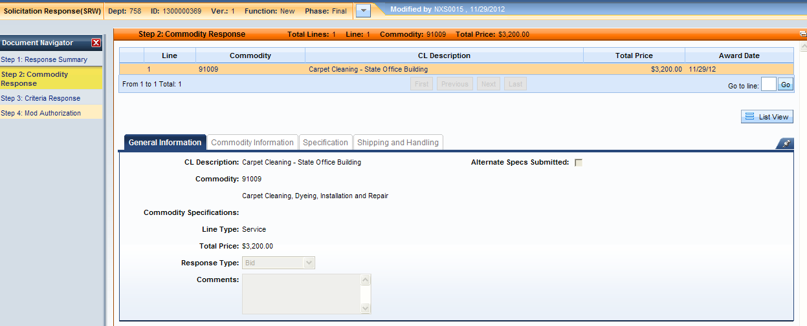
PROCEDURE 1 - Vendor Response
Complete the
Commodity Response Section
Required Information
Price
Validate, Submit and Approve the SRW

Slide 17
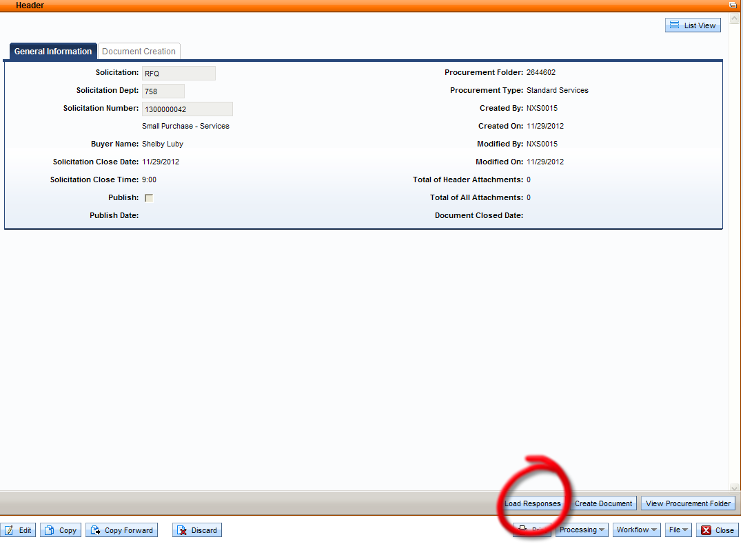
PROCEDURE 1 - Evaluation
Copy Forward from the RFQ to create the EV.
Clicking on the Load Responses link will bring all Solicitation Responses into the EV.

Slide 18
PROCEDURE 1 - Evaluation
Attach a RFQ Determination & Finding (D&F) located on the Office of Procurement Services website.
http://finance.ky.gov/offices/controller/Pages/ops.aspx

Slide 19
PROCEDURE 1 - Evaluation
Choose Award by Total section to award all items to the selected bidder.

Slide 20
PROCEDURE 1 - Contract Award
Generate the award from the Document Creation section of the EV header.
Create a PO/PO2 (or CT/CT2 - FAC & KYTC only) contract document from the EV.

Slide 21
PROCEDURE 2 - Email/Fax Process
Agencies choosing to complete the Email/Fax process shall:
Send either the RFQ or an agency form containing specifications and terms & conditions to all selected vendors including the ethnic minority and SDVOSB vendors identified through the VENDCMBT search.
After the closing date, create a RFQ Determination & Finding (D&F) located on the Office of Procurement Services website. http://finance.ky.gov/services/eprocurement/Pages/default.aspx

Slide 22
Determination & Finding
The RFQ D&F must include:
RFQ issue date and RFQ due date
Names, addresses and contact information for solicited vendors
Indication of which vendors are ethnic minority vendors
All prices quoted
A comment if no minority vendors were available
Justification for award

Slide 23
Reports
HB161 requires the Finance and Administration Cabinet to submit an annual report detailing efforts to assist SDVOSB Small Purchases.
Reporting of ethnic minority small purchases is currently not required.

Slide 24
Questions

