Slide 1
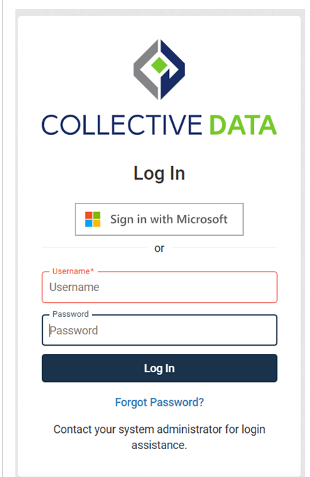
Navigation from KHRIS will lead you to this page. When you log in to the portal, you will need to click on the “Sign in with Microsoft” button to log on.

Slide 2
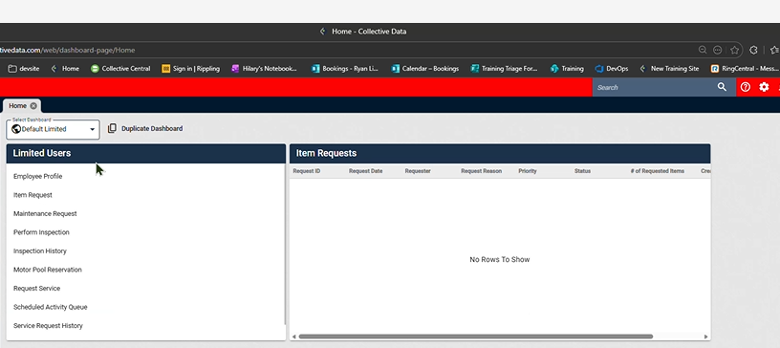
Motor pool reservation will show on the left side. Please click it.

Slide 3
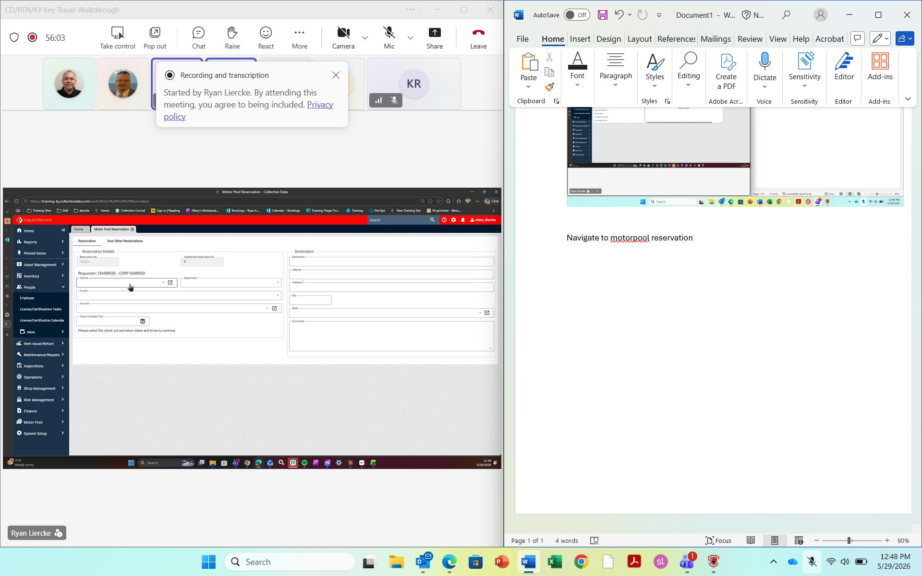
This window will pop up.

Slide 4
Cabinet and department must be filled out.
This is your eMars account.
Please fill out time of check out.
A pull-down menu will appear after the time to request vehicle type.

Slide 5
An email will be sent to you within 5 minutes of seeing “your request has been submitted” on your screen.
The email will have a 6-digit pin number. You will need this to retrieve the key.

Slide 6
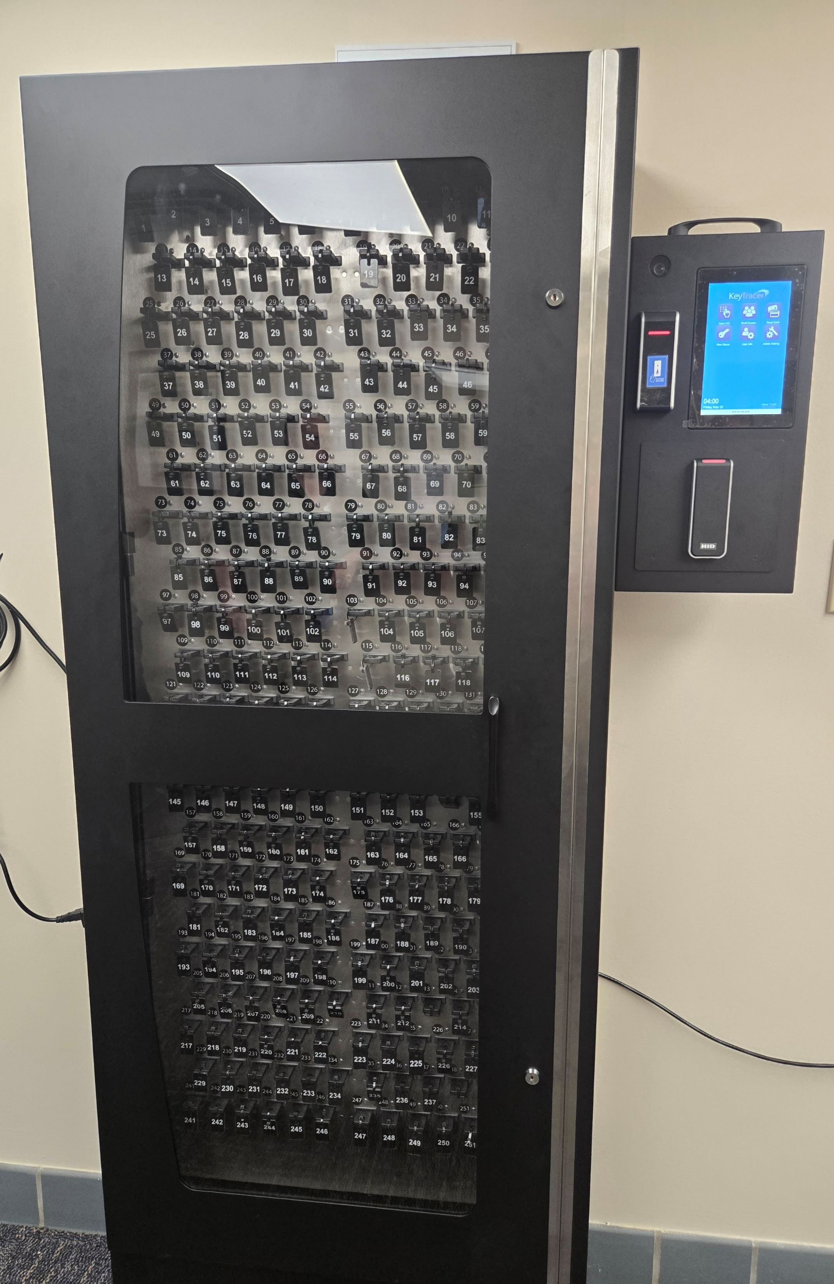
This is the machine you will look for upon entering Motorpool.

Slide 7
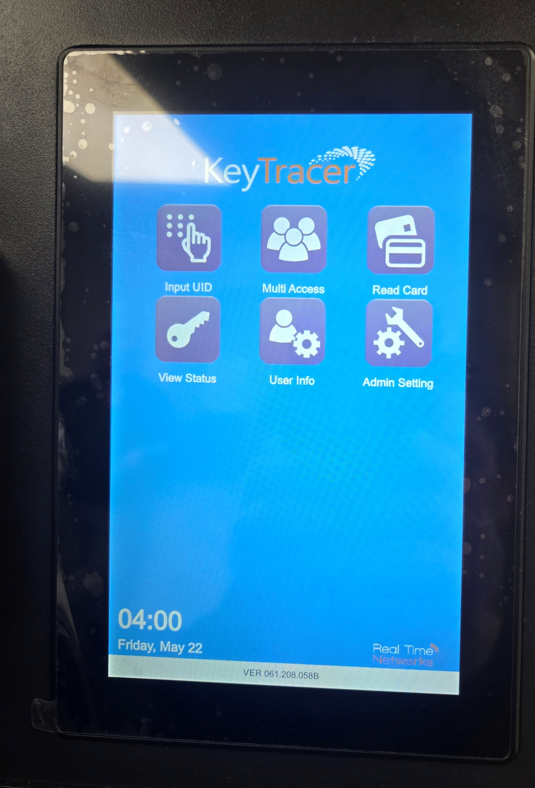
On the right-hand side of the machine this will appear. You will press Input UID

Slide 8
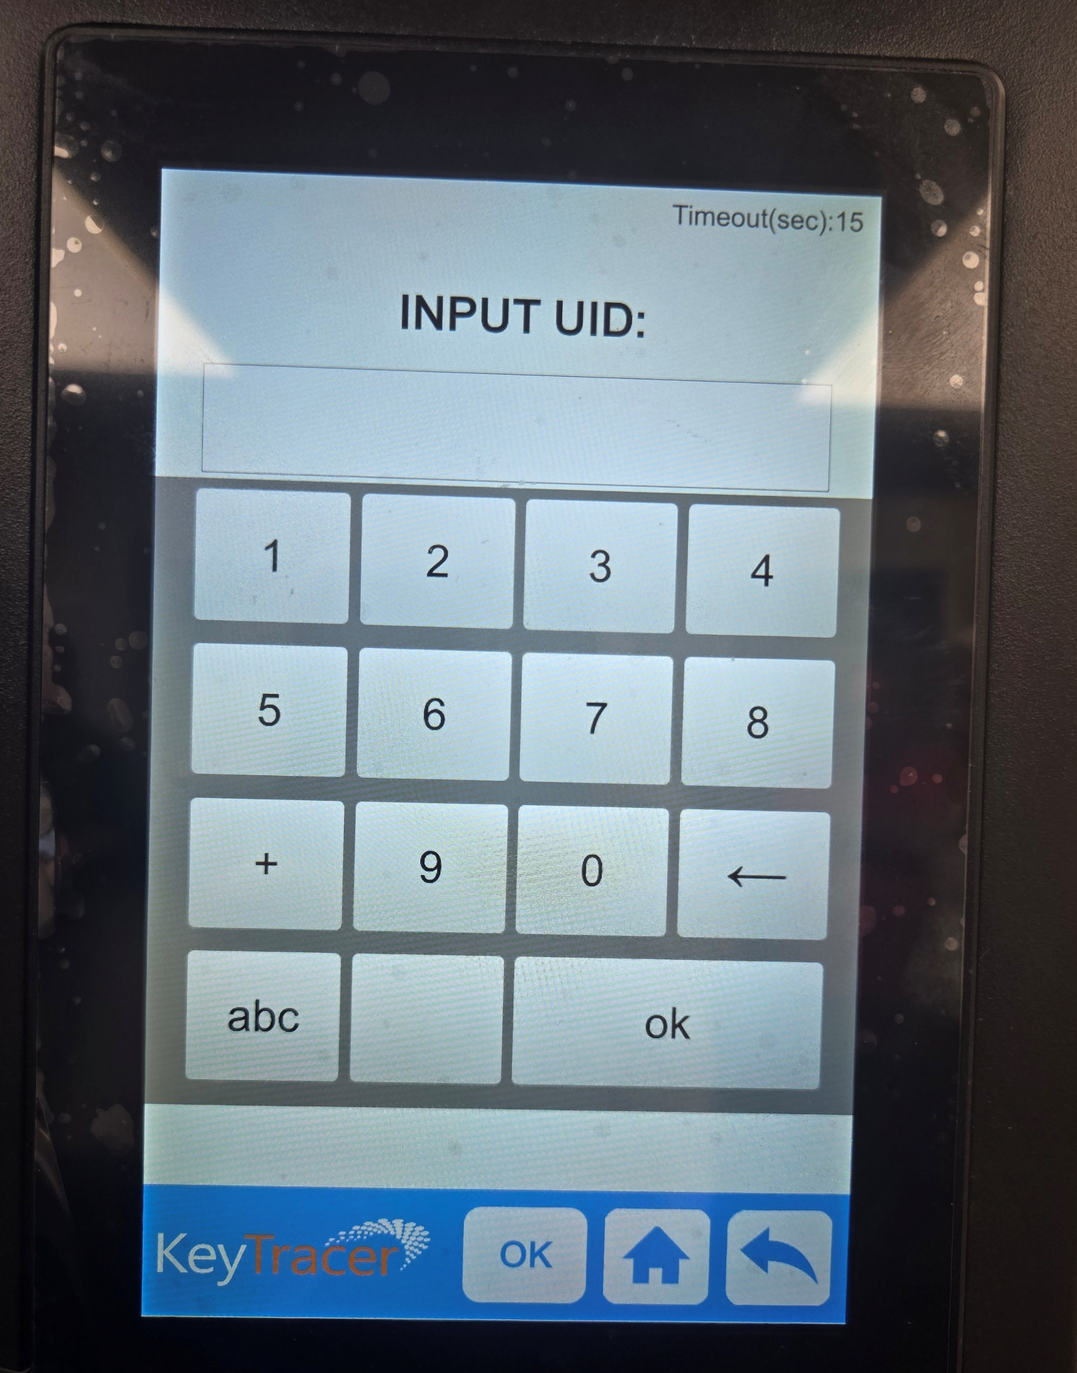
Upon pick up you will put in your six-digit code provided in your email here.

Slide 9
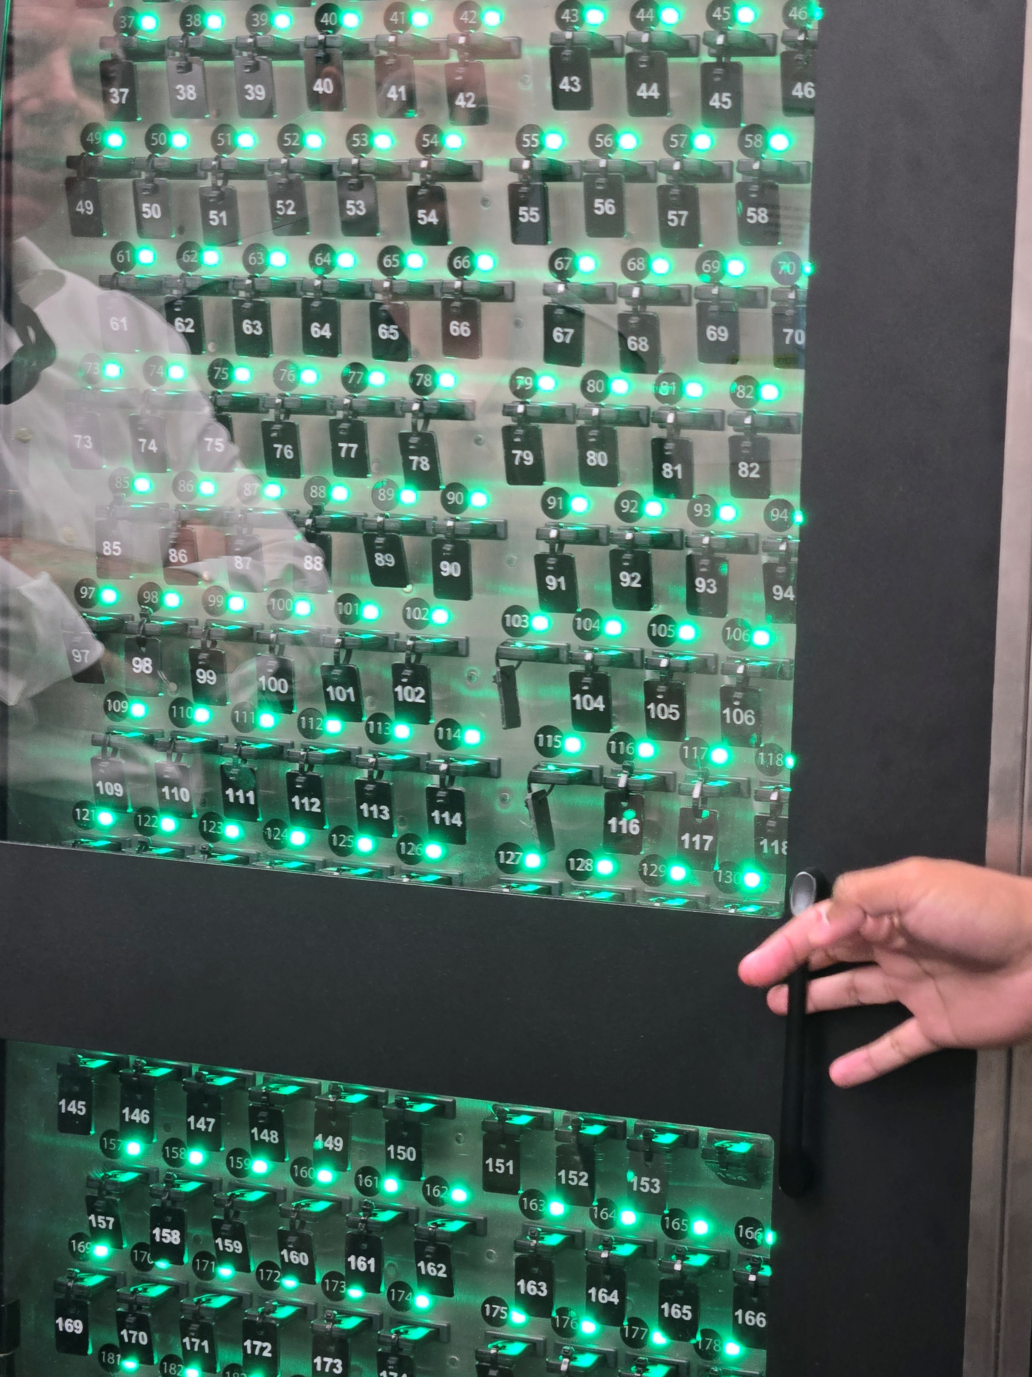
Only the key you will take will light up green

Slide 10
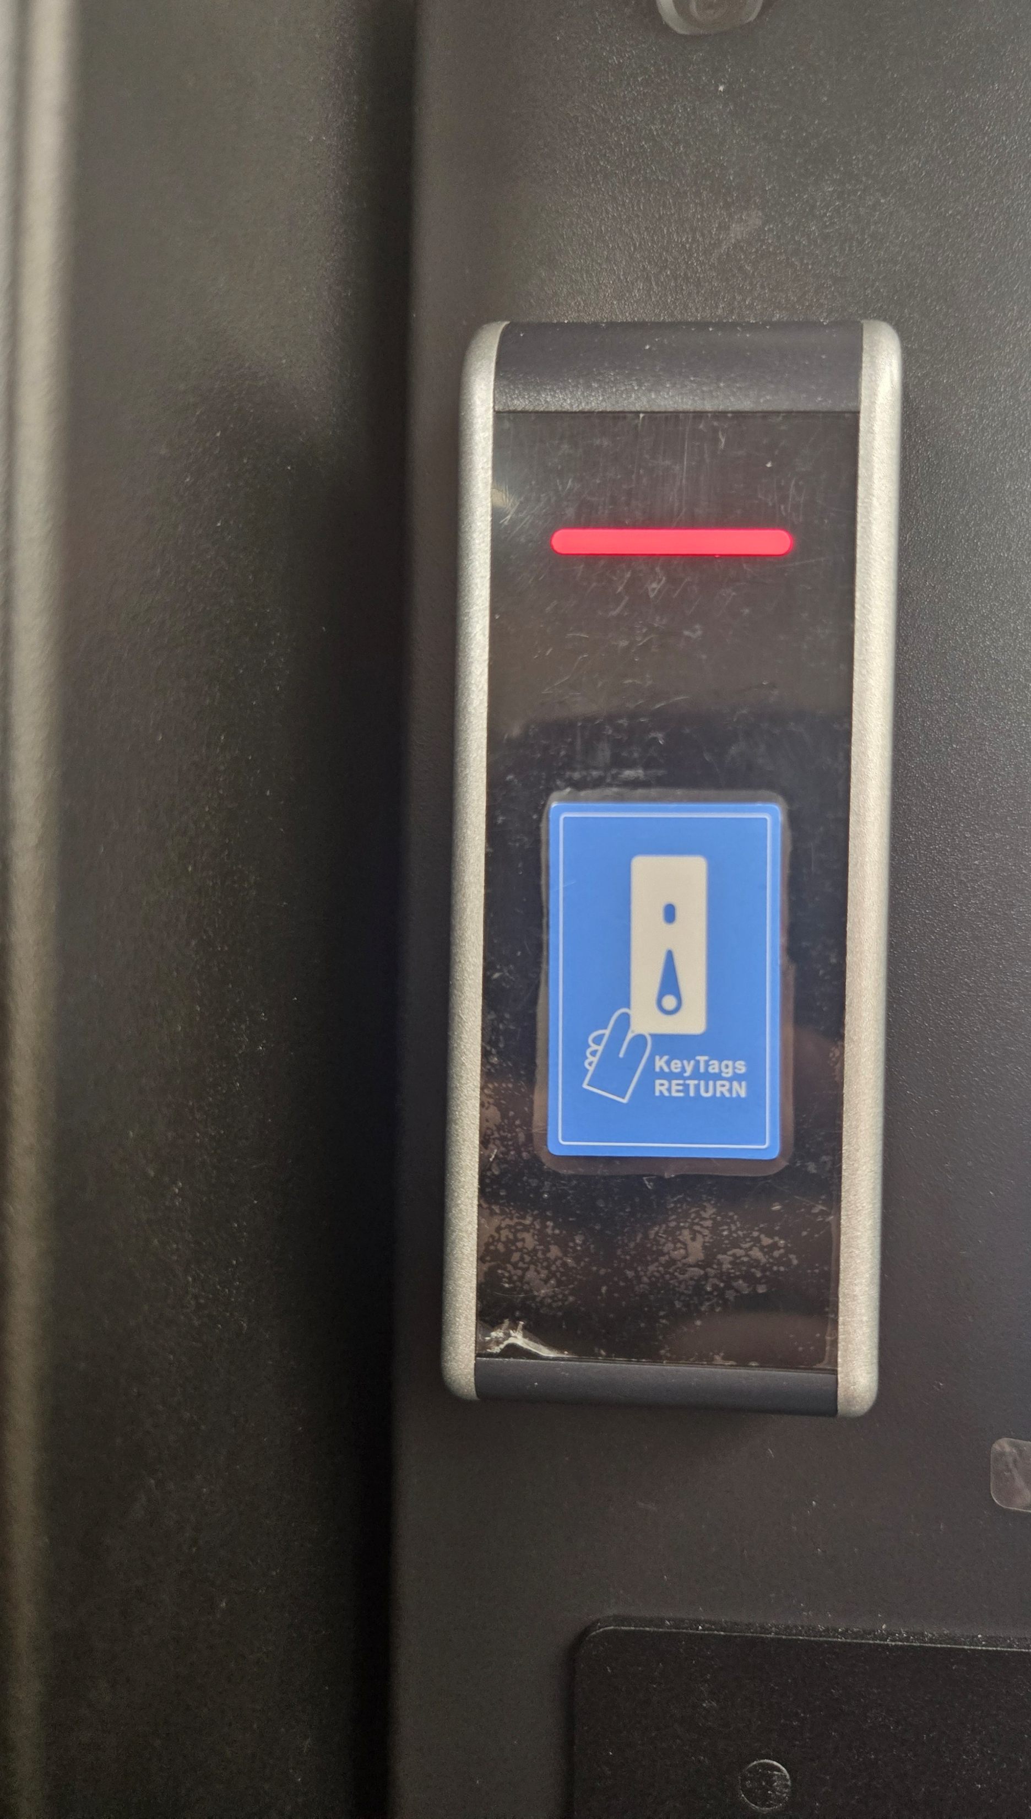
When you return it you may scan the key and then the spot that you will put it in will light up.

