Slide 1
eMARS End-User Training
Chart of Accounts
Part 2 - COA Maintenance & Cash Control
*Part 1 @ https://finance.ky.gov/Office-of-the-Controller/Office-of-Statewide-Accounting-Services/customer-resource-center/Pages/Training-Materials-and-Tutorials.aspx

Slide 2
Welcome
Presenter: Lindsey Wood, Graduate Accountant II
Office of Statewide Accounting Services, OOC
This training session has been pre-recorded.
Questions? Contact information will be provided at the end of the presentation.
Class Duration: approx. 45 minutes

Slide 3
Topics
Chart of Accounts Maintenance
COA combinations and requirements
Accounting Templates and Profiles
Cash Controls

Slide 4
Brief overview
Our eMARS’s Chart of Accounts functionality provides an account structure to classify financial information according to the dimensions needed to support the various uses of the Commonwealth’s financial information.
In this way, one can measure where monies are collected and spent.
We classify our Accounts into 5 categories.
Organizational – tracks accounting activities based on the cabinet/department structure and any lower level organizations within each department.
Fund Accounting – tracks fund and general ledger based accounting activity across the Commonwealth.
Budgetary – tracks accounting activities against our legal budgets.
Cost Accounting – tracks accounting activity associated with special purposes such as grants and projects.
Other Classifications - provides other elements for reporting and tracking transactions across different funds and organizations.

Slide 5
Chart of Account maintenance
“Maintenance” includes the establishment, deactivation, reactivation, deletion, and/or modification of a COA element.
The documentation required for Chart of Account maintenance largely depends on the COA’s category and its purpose.
COA Maintenance can be categorized into two main groups:
Central Chart of Account maintenance
Organizational, Fund Accounting, Budgetary
De-central Chart of Account maintenance
Cost Accounting, Other classification (departmental reporting)

Slide 6
Central Chart of Accounts
Organizational
Cabinet, Department, Division, Branch, Section, Unit
COA maintenance is initiated via the Re-organization process.
The agency collaborates with Personnel and OSBD to determine the details of the re-organization.
The Office of Statewide Accounting Services reviews the proposed changes to the Chart of Accounts during the draft/review process.
SAS implements all Chart of Account changes detailed in the Final Re-org packet.
** Any request for maintenance to the Unit element, outside of a re-org, requires an email request to Statewide Accounting Services.

Slide 7
Central Chart of Accounts - cont.
Fund Accounting
Fund, Object, Revenue, Balance Sheet Account
Budgetary
Function (Function Group, Function Type)
Both categories require a SAS-14 request form.

Slide 8
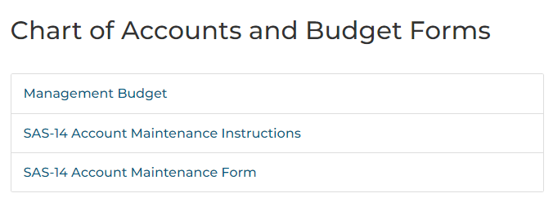
SAS-14 request form
The request form and Instructions can be located on Finance’s website.
https://finance.ky.gov/Office-of-the-Controller/Office-of-Statewide-Accounting-Services/customer-resource-center/Pages/eMars-Forms.aspx
* Certain fields must be populated, depending on the request action.

Slide 9
SAS-14 request form – Action & Reason
Action – Select the nature of the request: Establish, Inactivate, Change
Reason for Change – This field should be used for additional details of the request.
Not limited to the “Change” action.
FY – Select the fiscal year from the drop-down list.
After the New Year Table Initiator (NYTI) job is run in early May, it is important to specify all impacted Fiscal Years: Current FY, New (upcoming) Fiscal Year, or both.
DEPT – Select the appropriate department from the drop-down list.
Indicate if the request will require an update to the VFDF table.
Specific to “on-budget” Funds.

Slide 10
SAS-14 request form – Function, part 1
FUNCTION GROUP/TYPE - Complete this section when requesting:
1) to establish, change, or inactivate a Function Group or Function Type
Function Group (AP) code – represents the Appropriation.
Function Type (AL) code – represents the Allotment.
Must include the Function Group name and/or Function Type name.
and/or
2) override an Allotment account
Override Allotment - If requesting an Allotment override, select this check box. The From/To dates must be completed as well as the justification for the override.
*The end date of an override cannot exceed the end of the current fiscal year, without prior approval from OSBD.

Slide 11
SAS-14 request form – Function, part 2
FUNCTION – Complete this section when requesting to establish or inactivate a Function code.
Fund code – required to determine where the Function code can be expended from.
* If a new fund is being requested on the same form, the requestor can enter an asterisk (*) in the fund field. OSBD and SAS will infer the new Fund code.
Function Group (AP)code - represents the Appropriation
Function Type (AL) code - represents the Allotment
Function code being requested
Function Name

Slide 12
SAS-14 request form – Fund, part 1
FUND – Complete this section when requesting to establish, inactivate or change a Fund.
Fund Type - Select from the drop down list. (Used for Financial reporting purposes)
Fund code
To inactivate or change an existing Fund, enter the Fund code.
To request a new Fund, leave the Fund field blank.
Operating Account - If requesting a new Fund for an Operating Account, Statewide Accounting Services will assign the Fund code and notify OSBD.
Capital Project - If requesting a new Fund for a Capital Project, the Governor’s Office for Policy and Management will assign the Fund code, and submit the SAS-14 to Statewide Accounting Services for processing as well as notify the agency contact.
Fund Name
For Restricted Funds Only – Select whether the restricted fund is on-budget or off-budget.
Function code – Specify which budget line the fund will be expended from.
(if on-budget)

Slide 13
SAS-14 request form – Fund, part 2
For Fund Types 1300, 1400, 6300, 6310 and 6350:
Legal citation, if any, authorizing the receipt of funds into a special revenue fund
Enter the statute or legal authority for the establishment of the special revenue fund.
Legal citation, if any, that restricts the spending from the source of funds
If there are restrictions on the use of the funds, enter the statute or legal authority defining these restrictions.

Slide 14
SAS-14 request form – Fund, part 3
Accrued Interest Income - If a Fund is to accrue interest income, an Accounting Template is required to capture the accounting information for where the interest will post.
Check the box, if the fund will accrue interest income.
The legal authority for the accrual of interest income.
The accounting string of where the interest will post. Fund, Dept, Unit and Revenue are required.
* If the accrued interest will post to a new Fund, leave the Fund field blank. (it will be completed by SAS).
All remaining fields are discretionary.

Slide 15
SAS-14 request form – Fund, part 4
Override Cash – If requesting a cash override on a fund, check this box.
Justification for the override and the From/To dates must be included.
* The end date (To:) of the cash override cannot exceed the end of the current fiscal year.
Require COA elements for Spending and/or Revenue – Departments may select certain Chart of Account elements to be required when a specific Fund is used on an eMARS document.
Check the appropriate boxes based on your departmental needs.
* Be sure to specify if the requirement is for Spending (Expenditure) and/or Revenue transactions.
** This section will be discussed further on a subsequent slide.

Slide 16
SAS-14 request form – Signatures and processing
An agency signature is required for submission.
Completed SAS-14’s should be submitted to the Governor’s Office for Policy and Management staff within OSBD for approval and signature.
Function-related actions will be performed by OSBD.
Fund-related actions will be forwarded to SAS for processing.
SAS will review the SAS-14 form, and update the necessary Chart Of Account Tables within the eMARS application.
*If SAS has to create an Accounting Template for accrued interest, the Accounting Template code will be added in the ‘Template ID’ field.
Upon final processing, SAS will sign the SAS-14 and email OSBD with a copy of the final, signed form.

Slide 17
COA combinations and requirements
As part of the Chart of Accounts setup for a Fund, two combination tables may have to be updated:
Valid Fund Department Combination (VFD) table
A VFD record is required for every active fund.
This entry limits access to the fund to only the departments associated with the fund in a specified fiscal year.
Some funds may need to be eligible for use with multiple departments. This will require multiple records on the VFD table.
To access the VFD table, open Page Search from the Secondary Navigation panel and enter VFD in the Page Code field. Click the underlined link, Valid Fund Dept Combination.
* Only the Office of Statewide Accounting Services has the authority to update the VFD table. End-users have “read only” access.

Slide 18
COA combinations and requirements
Valid Fund Department Function Combination (VFDF) table.
The Valid Fund Department Function Combination (VFDF) table is used to identify valid combinations among the fund, department & function COA elements for a specified Fiscal year.
All on-budget operating funds are required to have a VFDF record.
A fund can have multiple department and function combinations.
* Agencies may include off-budget and capital funds on the table to ensure valid fund-department-function combinations, but this is not required.
To access the VFDF table, open Page Search from the Secondary Navigation panel and enter VFDF in the Page Code field. Click the underlined link Valid Fund Dept Function Combination.
* Only the Office of Statewide Accounting Services has the authority to update the VFDF table. End-users have “read only” access.

Slide 19
COA combinations and requirements
Fund Department Requirement (FDREQ) table
Departments may choose certain departmental COA elements to be required for a particular Fund & Department combination. (Optional)
may include: Activity, Sub Activity, Sub Function, Appropriation Unit, Reporting Code, Sub-Reporting Code, Department Object, Location, Sub-Location, Task, etc.
This optional requirement is set independently for Spending and/or Revenue type transactions.
*All funds with a CAFR Fund Type of “RSTD” or “FDRL” must have a FDREQ record to require the Function element, regardless of any other requirements the department may request.
To access the FDREQ table, open Page Search from the Secondary Navigation panel and enter FDREQ in the Page Code field. Click the underlined link Fund Department Requirements.
* Only the Office of Statewide Accounting Services has the authority to update the FDREQ table. End-users have “read only” access.

Slide 20
Accounting Template
Accounting Templates provide the ability to save frequently used chart of accounts data for use in subsequent document creation.
Templates are used to populate the fund and detail accounting elements on an eMARS document.
Purpose:
Reduce the amount of time it takes for repetitive data entry
Minimize human error
To access the Accounting Template table, open Page Search from the Secondary Navigation panel and enter ACTPL in the Page Code field. Click the underlined link Accounting Template.

Slide 21
Accounting Template
Accounting Templates are “de-centralized” records.
Authorized end-users can create, delete, and/or modify their own Accounting Template records.
CAUTION
The only fields required in order to save a record are: Accounting Template code, Name, and Department
Accounting Templates do not require specific Fund Accounting or Detail Accounting COA elements.
Unlike other COA-related tables, the system does not verify that the inputted values are valid or active when saving a record.
This can lead to potential errors and additional required input by the user during the document validation process.
* The accounting information inferred from the Template should still be reviewed and verified by the end-user.
The COA elements are inferred from the Accounting Template upon validation of a document.
* The Accounting Template record must be marked as “Active”.
*Any accounting elements that have already been entered on the document will not be overlaid with the values from the accounting template. The template will only default values on blank fields.

Slide 22
Accounting Profile
The Accounting Profile groups together multiple Accounting Templates which are assigned accounting distribution percentages.
To access the Accounting Profile table, open Page Search from the Secondary Navigation panel and enter ACTPR in the Page Code field. Click the underlined link Accounting Profile.

Slide 23
Accounting Profile
provide the ability to centrally store multiple accounting strings with percentage distributions tied to each
help to facilitate and standardize data entry.
only available on select documents.
CA, PRC, GAX, TP, TE, ITI, ITA, IET
Like the Accounting Template, authorized end-users can create, delete, and/or modify their own Accounting Profile records.
The required fields include: Accounting Profile code, Accounting Profile Name, and Department.
This is all that is needed to create an ‘Inactive’ record.
An ‘Active’ record requires at least one defined Accounting Template.
The percentage of all Accounting Template lines must total 100%.

Slide 24
eMARS Reporting – Statewide Report Accounting Templates & Profiles
Documents > Public Folders > EMARS Financial > Statewide Reports > Non- Financial > Accounting Templates & Profiles
Multiple query options
The results will display the Accounting Template code, the associated accounting string, the status, and Accounting Profile (if applicable).

Slide 25
Cash Controls
Rather than being controlled at the bank account or budget level, a Cash balance is obtained from one or more balance sheet accounts.
The Commonwealth identifies Cash as BSA 0110 (Cash On Deposit With Treasurer).
Cash is tracked at the Fund level.
Cash is reconciled by Fiscal Year.

Slide 26
Cash Controls
Setup:
When establishing a new Fund, SAS must create records on two Cash Maintenance tables.
The Fund setup process is not considered complete until the Cash Maintenance tables have been defined.
Cash Balance Detail Maintenance (CBALD)
Cash Balance Summary Maintenance (CBALS)
The maintenance tables provide options to define how cash is controlled.
* Both tables are for Admin use only.

Slide 27
Cash Controls- CBALD
Cash Balance Detail Maintenance (CBALD)
Cash Balance Error Severity – determines the level of error thrown when a transaction attempts to exceed the available cash balance. (No Error, Overrideable Error, or Error)
If a Cash Override is not requested & approved on the SAS-14, the default error severity level is “Overrideable Error”.
Pending Increase/Decrease Cash – determines if Pending eMARS transactions impact the current Cash balance.
By default, all Funds have both the Increase and Decrease values selected.
BSA record– the CBALD table also defines the Balance Sheet Account(s) that make up the “Cash” balance.
By default, all Funds have one BSA line, 0110 (Cash On Deposit With Treasurer).

Slide 28
Cash Controls- CBALS
Cash Balance Summary Maintenance (CBALS)
This table is very similar to the Cash Balance Detail Maintenance.
Includes both the ‘Cash Balance Error Severity’ and ‘Pending Increase/Decrease Cash’ parameters.
* The values for each should mirror the values from the CBALD table.
The Balance Control field (located on the CBALD table) indicates where the system edits are performed and formulation options are read.
All Funds have the value of ”Summary”, meaning the system refers to the Cash Balance Summary Maintenance table to determine the Cash balance rules.

Slide 29
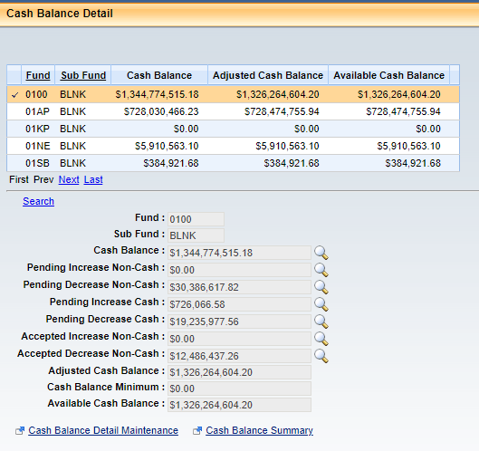
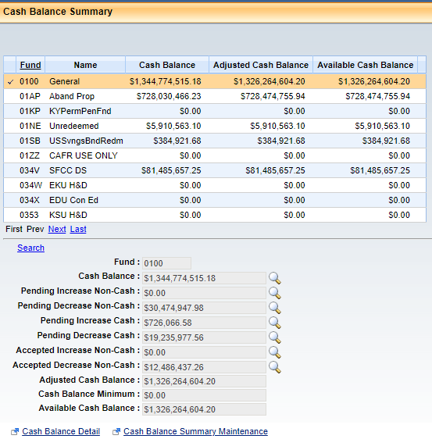
Cash Balance reference tables
Two Cash balance tables, within the application, are available for end-user reference.
Cash Balance Detail (PAGE CODE: CBALDQ)
Cash Balance Summary (PAGE CODE: CBALSQ)
Both tables are very similar, and display the exact same Cash balances.

Slide 30
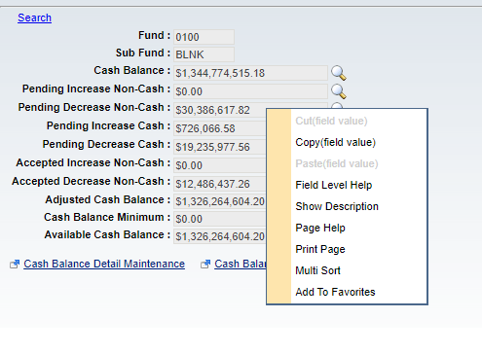
Cash Balance reference tables
All cash balances are updated in real-time.
updated when an document is pending and/or final status.
If you right-click on a particular cash balance amount, and select “Field Level Help”, the system will provide a definition of that particular cash line.
Ex. Pending Increase to Non-Cash:

Slide 31
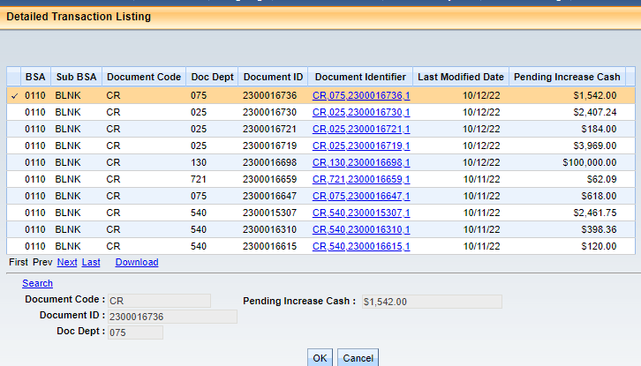
Cash Balance reference tables
If you click on the magnifying glass to the right of a balance, the system will display all transactions that made up the balance.
Ex. Pending Increase to Non-Cash
The transaction list can be
downloaded into an Excel file for
further analysis.
* Do NOT click on the magnifying glass for the 0100 Fund.
Too many transactions. It will lock up your session and cause you to close the application.

Slide 32
Questions and Feedback
For all Chart of Account questions, please email:
Lindsey Wood @ lindsey.wood@ky.gov
cc Jason Mach @ jason.mach@ky.gov
Please be sure to include “COA training” in the email subject line.
All General and Cost Accounting inquiries can be sent to SAS_Accounting@ky.gov.
Alternatively, you can reach out to your Department’s assigned SAS accountant.
Download the ‘Statewide Accounting Staff List’ from our website @ https://finance.ky.gov/office-of-the-controller/office-of-statewide-accounting-services/Pages/default.aspx

