Slide 1

THE POWER OF PARTNERSHIP
ONBOARDING ESSENTIALS FOR
The State of Kentucky
Updated 12/15/2022

Slide 2
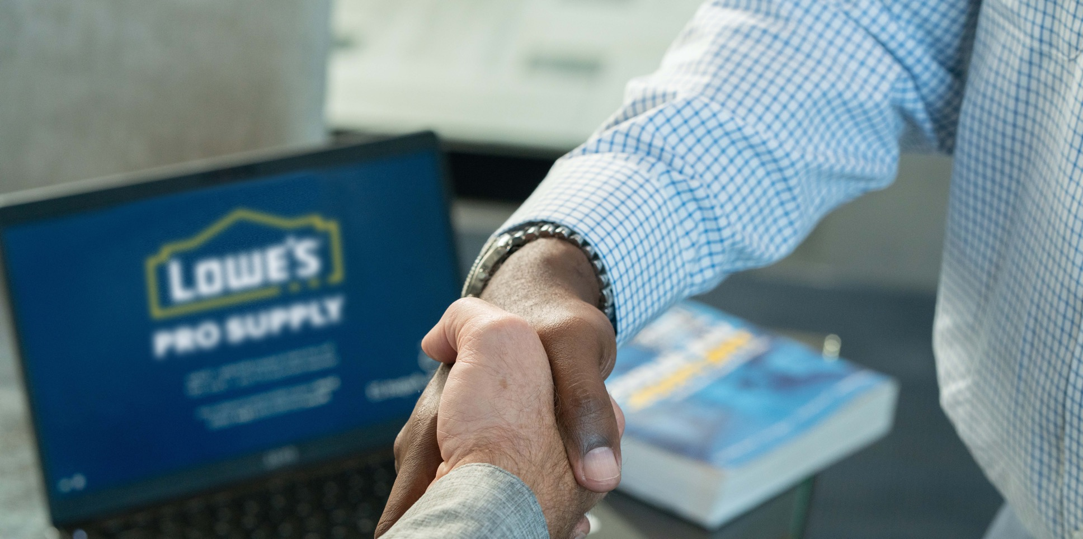

PRESENTATION DETAIL
  Layers of Support at Lowes
How to Order a Key Fob
Shopping through your Epro system

Slide 3
The State of Kentucky
SUPPORT TEAM AT LOWES
GOVERNMENT SUPPORT
National Account Manager- Government
Jason Finch
Jason.Finch@lowes.com
727-247-8645
LOCAL SUPPORT
PRO SALES MANAGER
Your go-to contact providing boots-on-the-ground support to the agency and maintenance teams for ADOT. Including: help with products, setting up store points of contacts, best practices, etc.
LOWE’S E-PRO SUPPORT
Support regarding Lowe’s Punch-out site.
EPROSUPPORT@LOWES.COM
CUSTOMER ONBOARDING
SUPPORT
Help for new agency or new division set up
Customeronboarding@lowesprosupply.com

Slide 4
Ready to get started?
Your shopping experience to
GET THE JOB DONE
KEY FOBS:

Slide 5
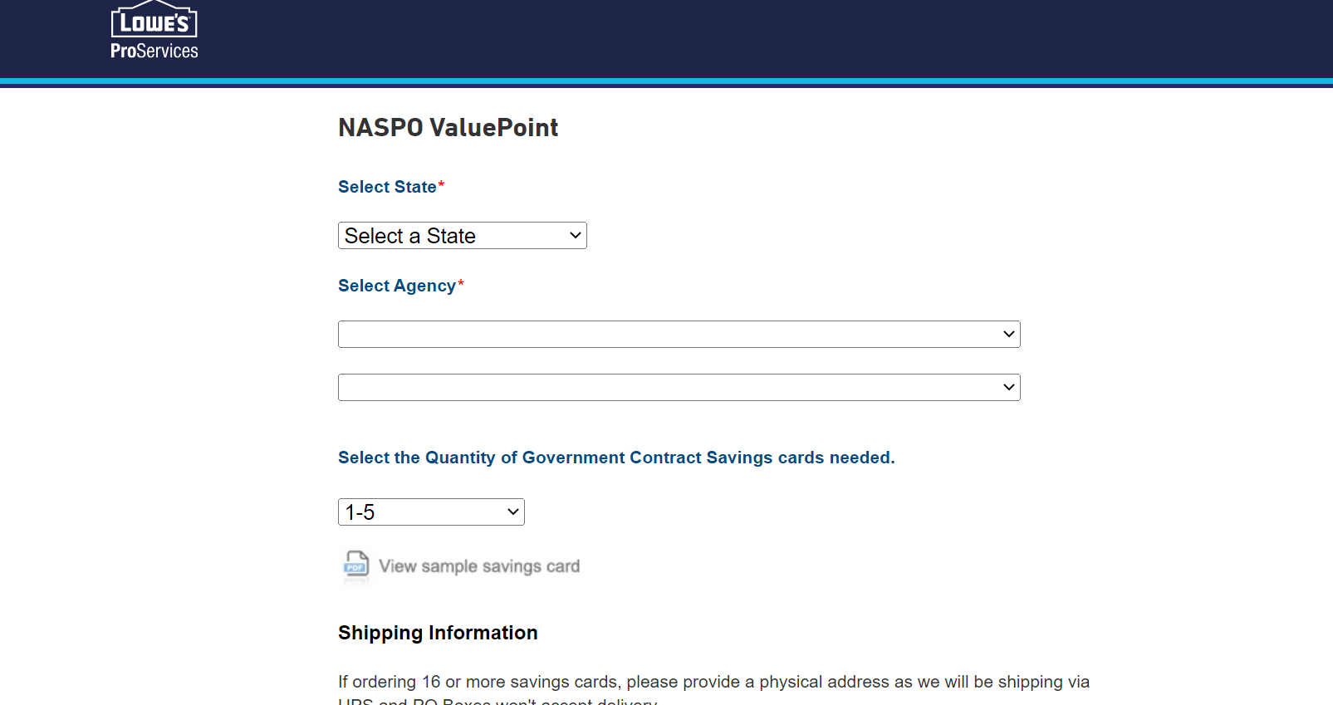
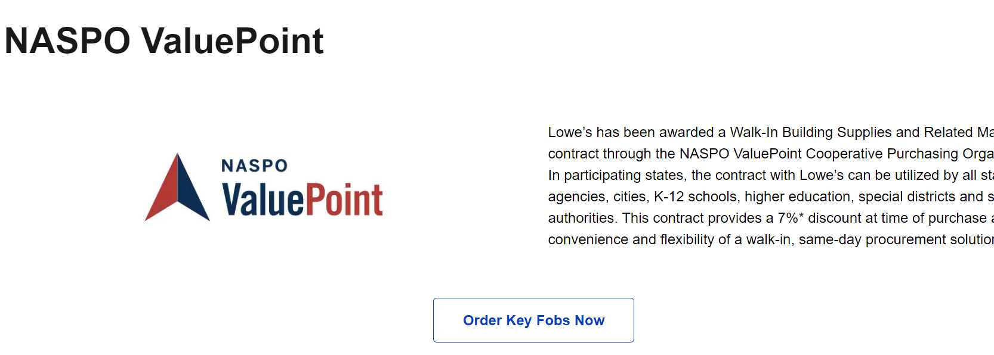
INTERESTED IN GETTING A KEY FOB?
STEP 2:
Once you click on “Order Key Fobs Now”. It will prompt you to the screen below and you will add in all required information. Submit once completed.
STEP 1:
To obtain the Key Fob you will need to go to:
Purchasing With NASPO ValuePoint (lowes.com)
That link will prompt you to the screen below:
CLICK HERE!:

Slide 6
Ready to get started?
Your shopping experience to
GET THE JOB DONE
PROCUREMENT SYSTEM:

Slide 7
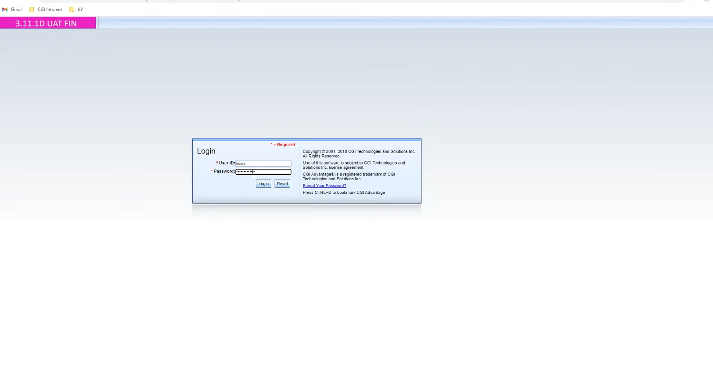
Step 1: Login to your account

Slide 8
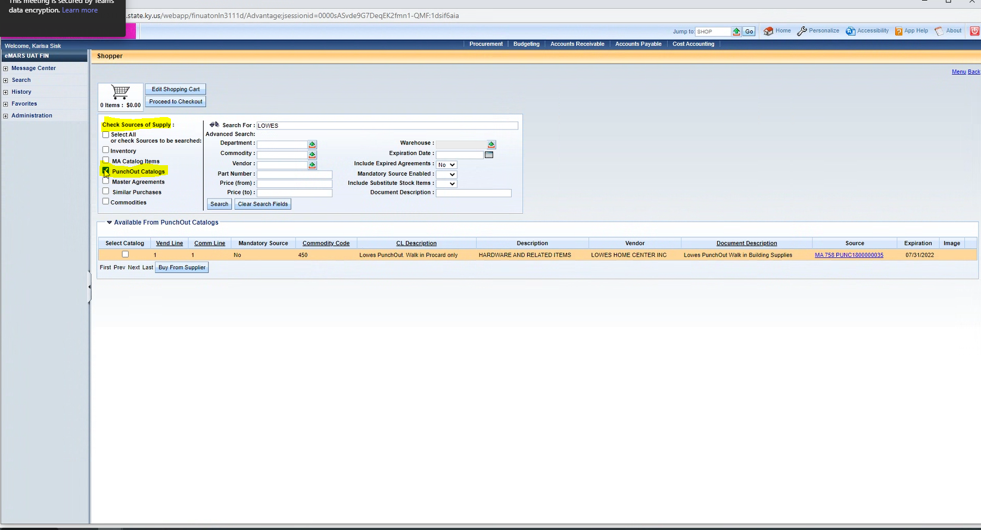
Step 4: (visual)
Step 2: Jump to: SHOP
Step 3: Go to Check Sources of Supply and select “PunchOut Catalogs”
Step 4: Type in Lowes in the “search for” section

Slide 9
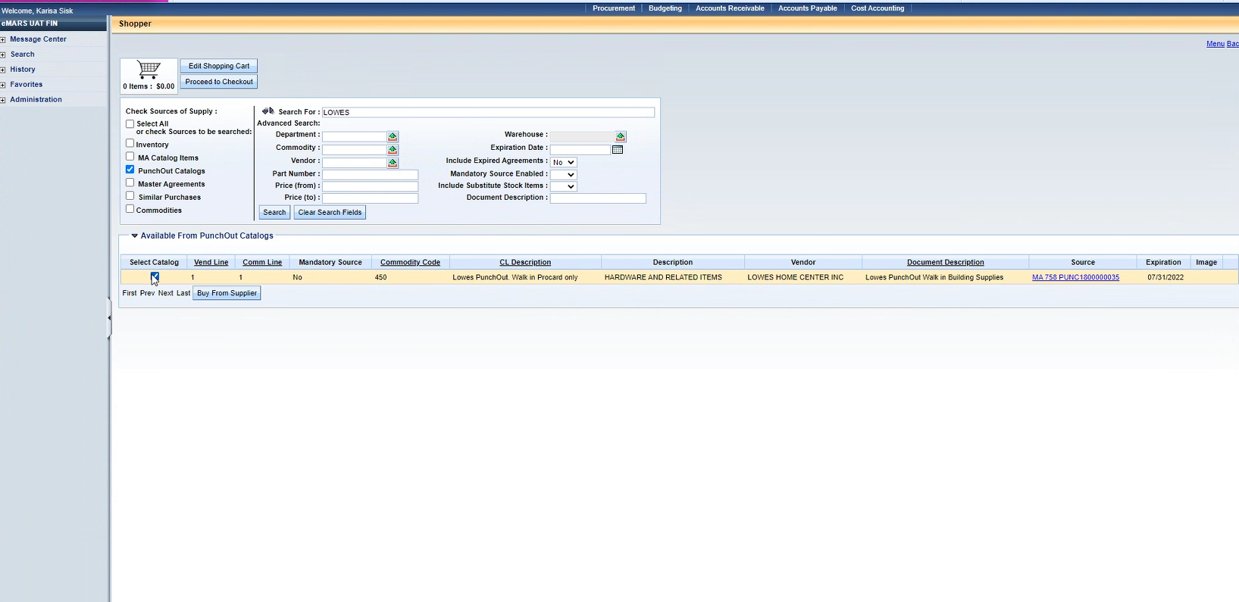
Step 6
Step 5
Step 5) Identify and then check the box (Select Catalog) to buy from the chosen supplier
Step 6) Click on Buy from Supplier

Slide 10
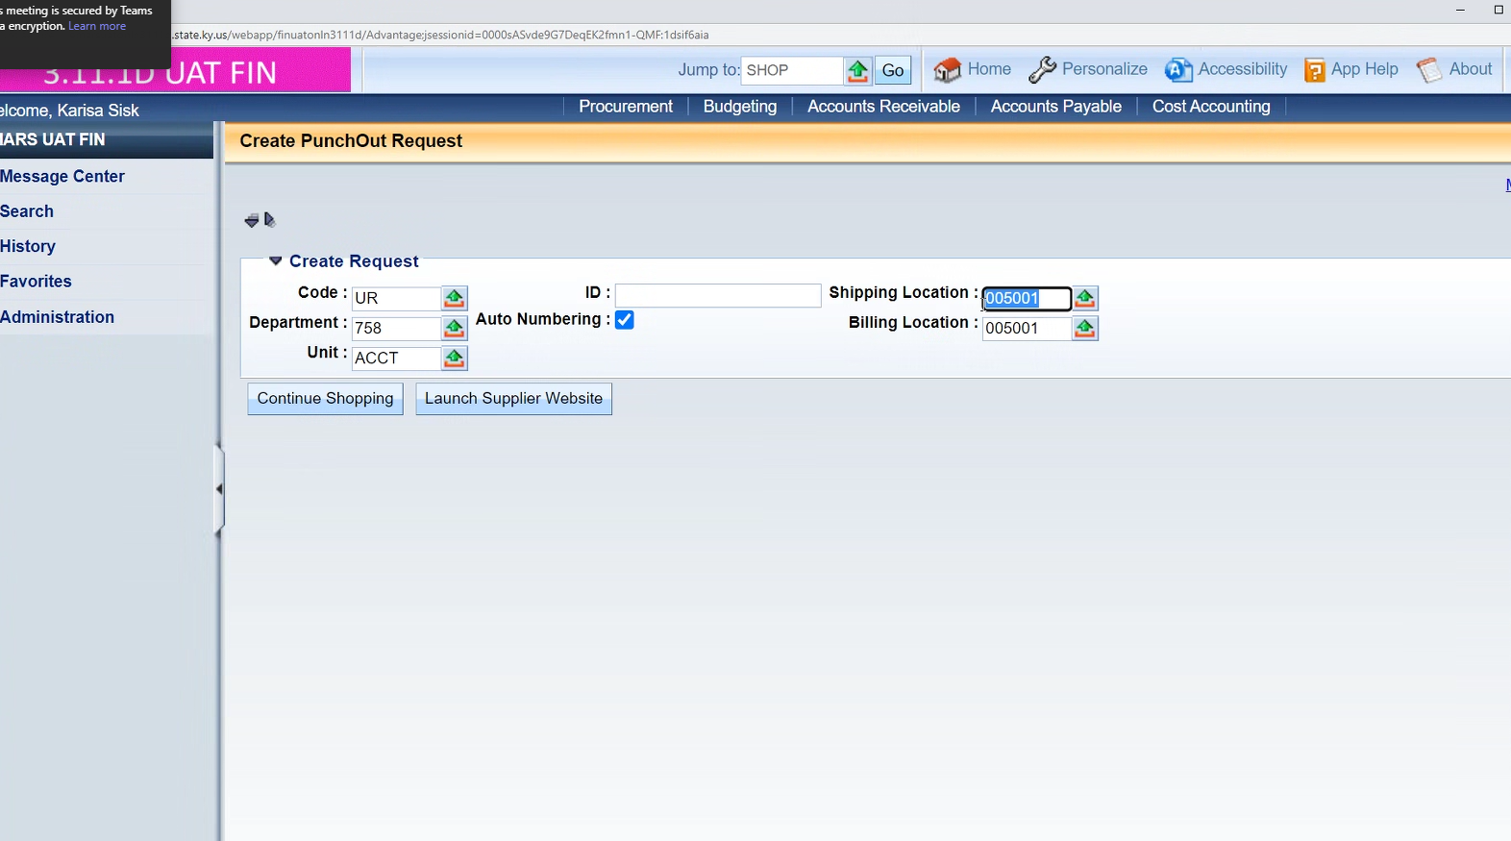
Step 7) Enter in your shipping and billing locations
Step 8) Once you have added in your shipping and billing location codes, hover over and click on “launch supplier” website

Slide 11
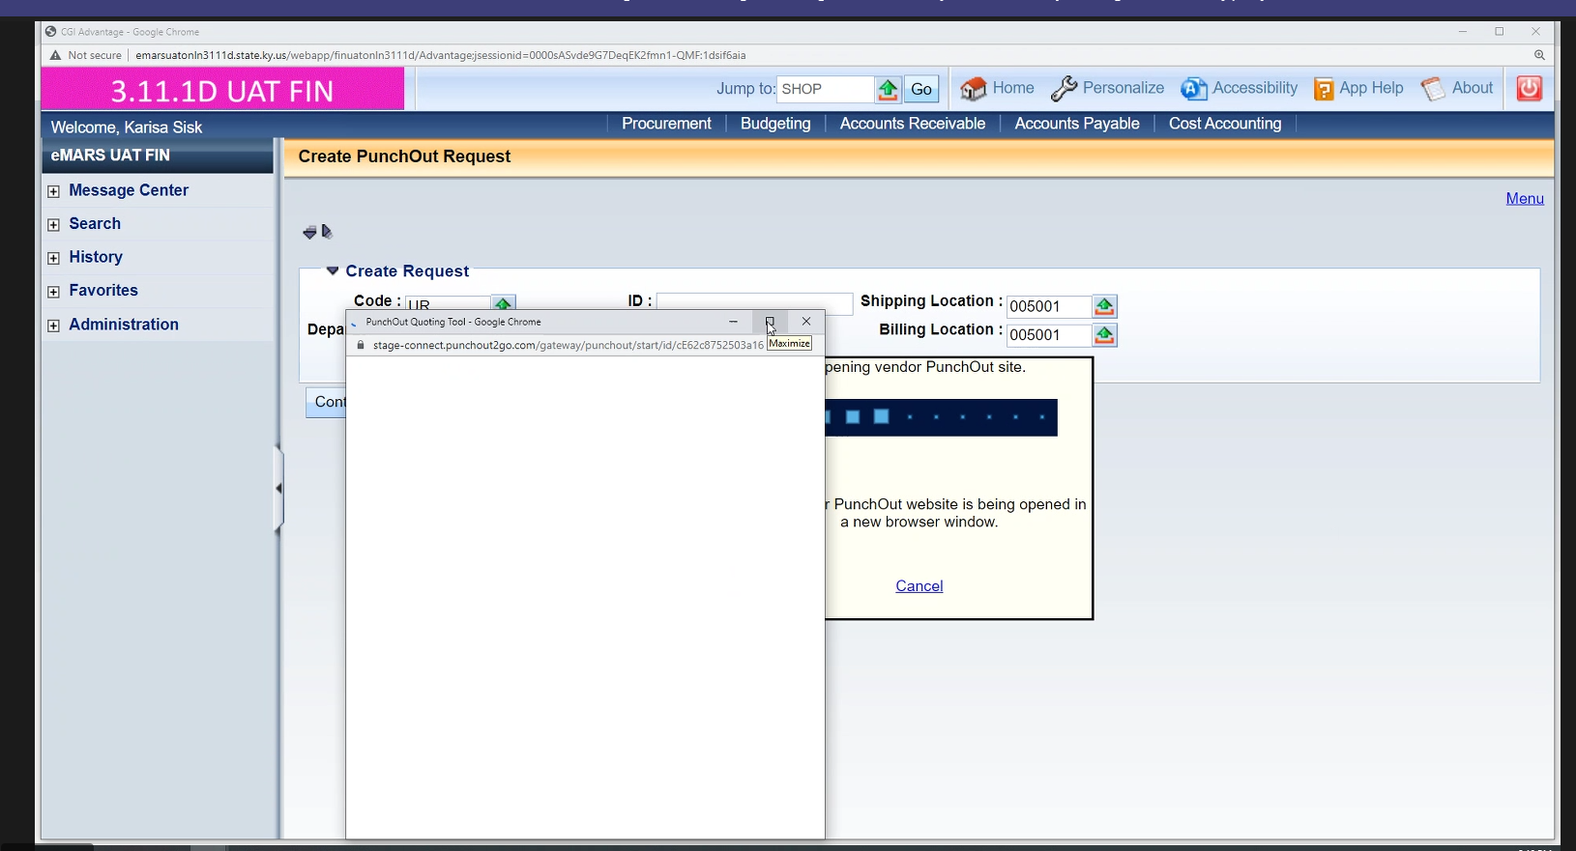
Quick Tip 1: Make sure your pop ups are enabled

Slide 12
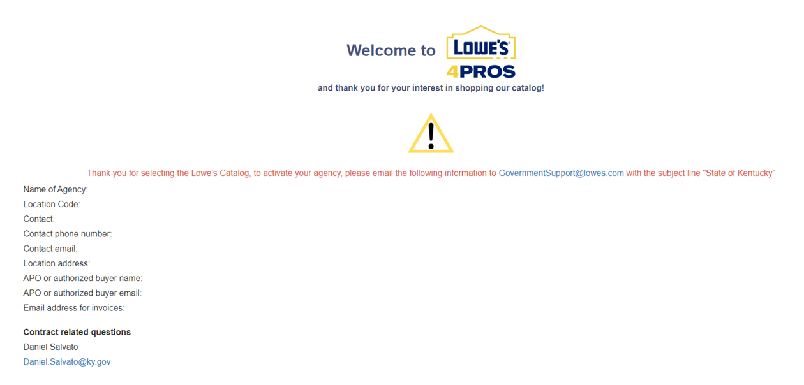
Lowe’s Splash Page for Agencies not set-up
If your agency is not set-up once you complete step 8, you will be directed to this specific splash page. Your call-to-action item is sending an email to governmentsupport@lowes.com and providing the information that is listed directly to the left. Your subject should read, “State of Kentucky.” Once you do that, your agency set-up process begins, and you will be sent more information by email once the accounts are created.

Slide 13
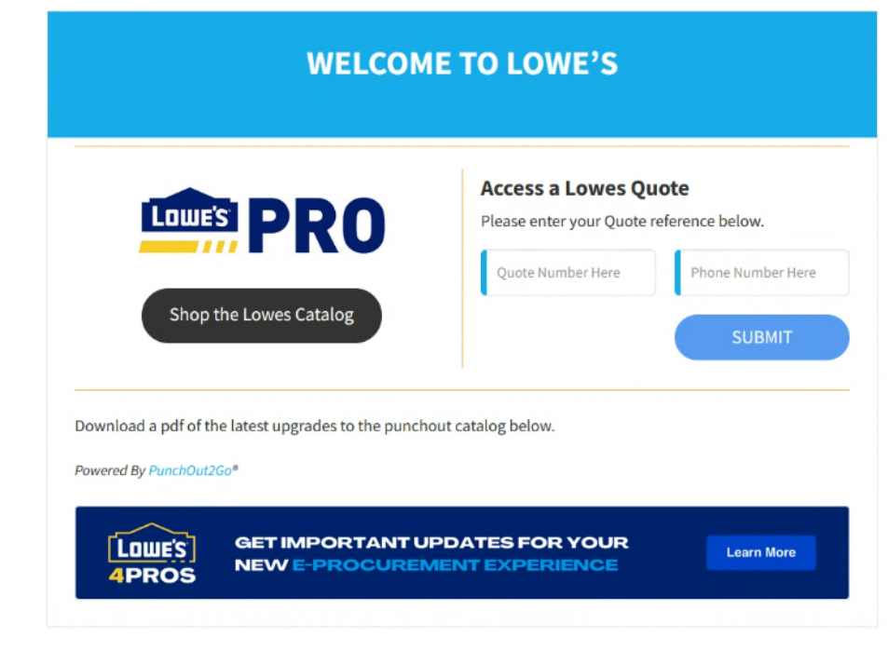
Welcome to Lowe’s Page- agencies that are ready to shop
This will take you into your shopping experience here!
Quick Tip #2
Are you working off a quote? You can search it here!
If your agency is set up (your bill to and ship to are set up) you will go straight to this page which allows you to start shopping the Lowe’s Catalog. Click on Shop the Lowe’s Catalog if you are ready to search products and place orders or access an old quote by following Quick Tip #2

Slide 14
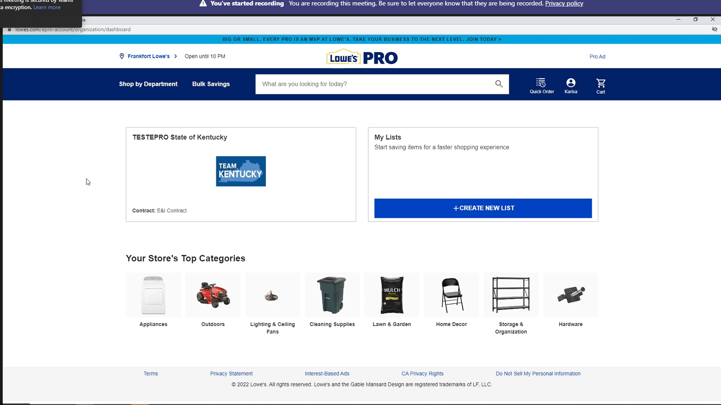
Step 9: When you first get into your punchout, select the store (location) where you want to shop.
Step 10: Once you set your location, you can start searching products and adding them to your cart.
Quick Tip #3- You can create lists (possibly favorites) for items that you know you will be purchasing often. Lists that are created are your own and not anyone else's.

Slide 15
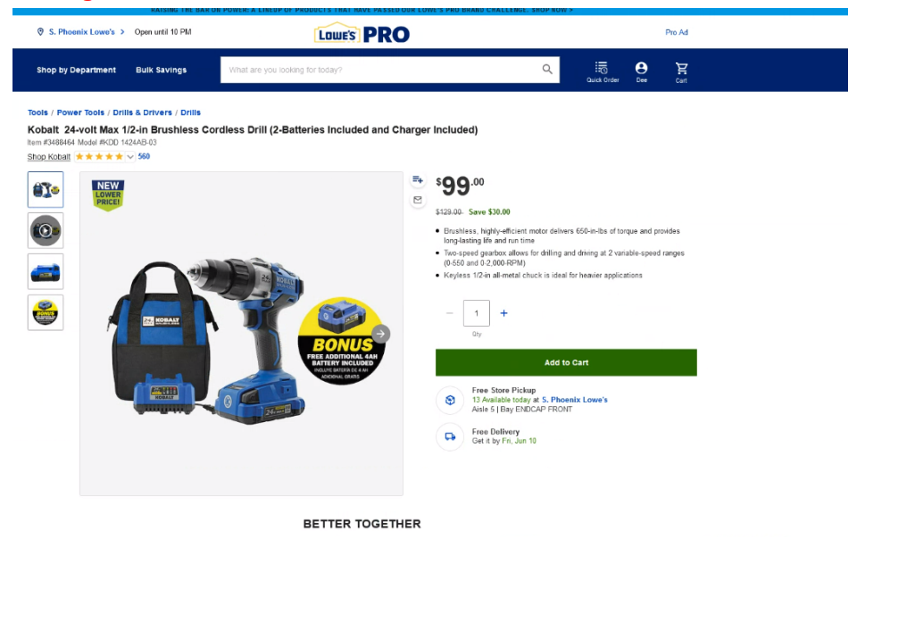
ADDING ITEMS TO YOUR CART
When adding items to your cart
Step 11: Search your product
Step 12: Select your product
Step 13: Add your product and the quantity to the cart
Step 14: Select your product fulfillment option for each product you put in your cart (REQUIRED)
In store pick-up, delivery, etc.
This must be done for each item that you select and put into your cart- see next slide for more on how to receive your product
Your contracted Price will list above the retail price
Fulfillment options will display below “Add to Cart.”

Slide 16
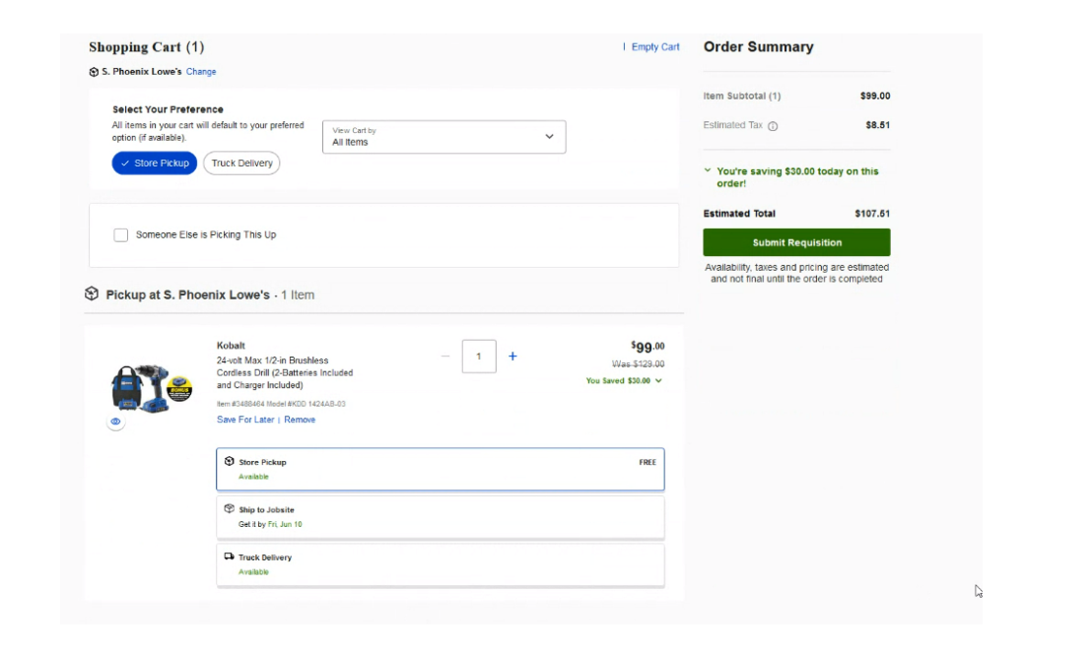
SHOPPING CART VIEW AND RECEIVING OPTIONS
Quick Note:
You must select your fulfillment option for each item that you place in your cart and there are 3 fulfillment options. When shopping online you are either shopping from a local store or you are shopping from distribution and you designate the source during your shopping experience.
Option 1: Store pick-up is free (select the local store you want to shop at- you did this in Step 9)
Option 2: Ship to Jobsite: $5.99 (free on orders over $49.00) this ships direct from supplier or a Lowe’s DC to selected location
Option 3: Truck Delivery ($20 contracted price) – delivered from the store to your selected location ** may be longer lead time as the store needs to receive items and coordinate delivery**

Slide 17
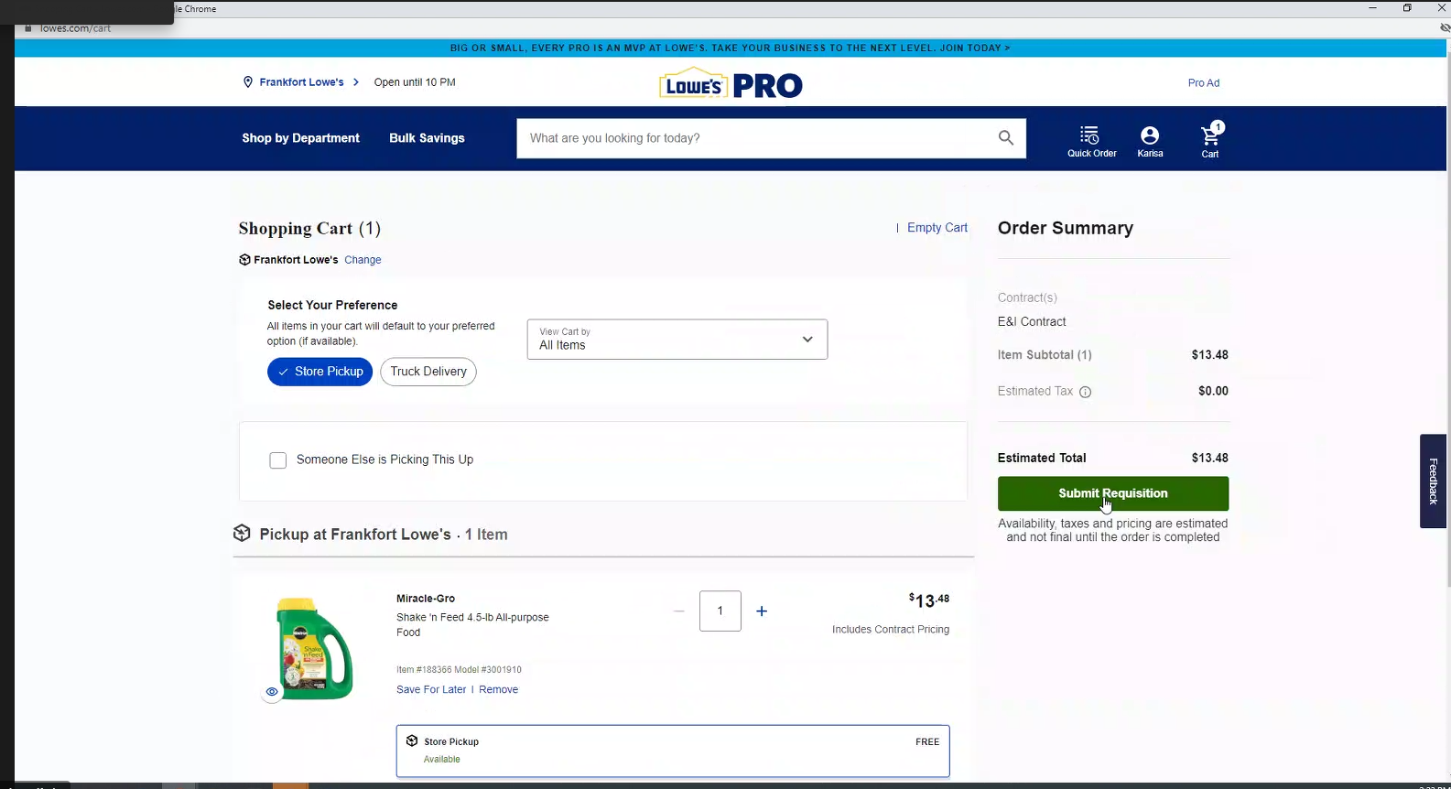
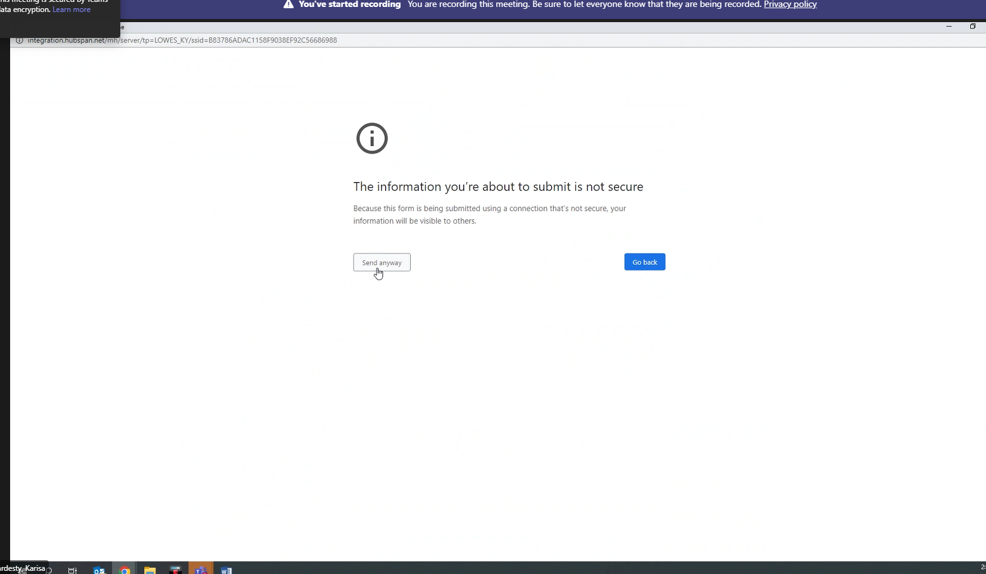
Step 15: Once you have added your product needs to your shopping cart, you selected your fulfillment options for EACH ITEM, and you are ready to finish your order, you will click on “Submit Requestion” in Green
Step 16: Once you hit “submit requisition” it will take you to this page. Go ahead and click on
“send anyway.”

Slide 18
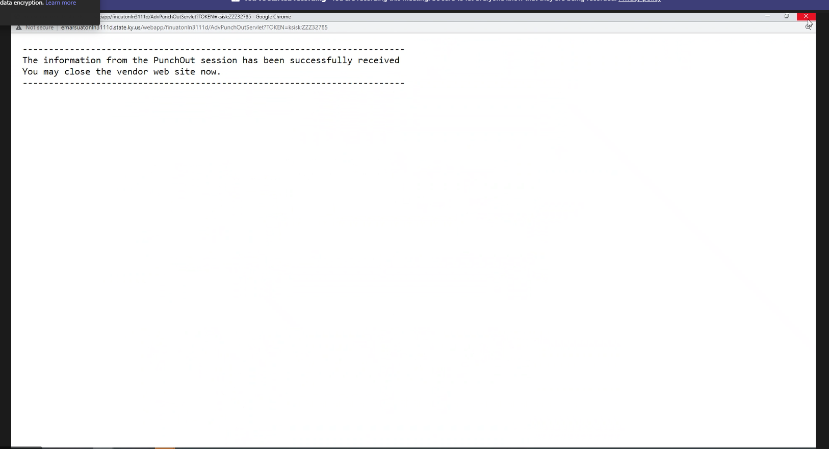
If this screen pops up once you have submitted the requisition, please hit the X button to move out of this window.

Slide 19
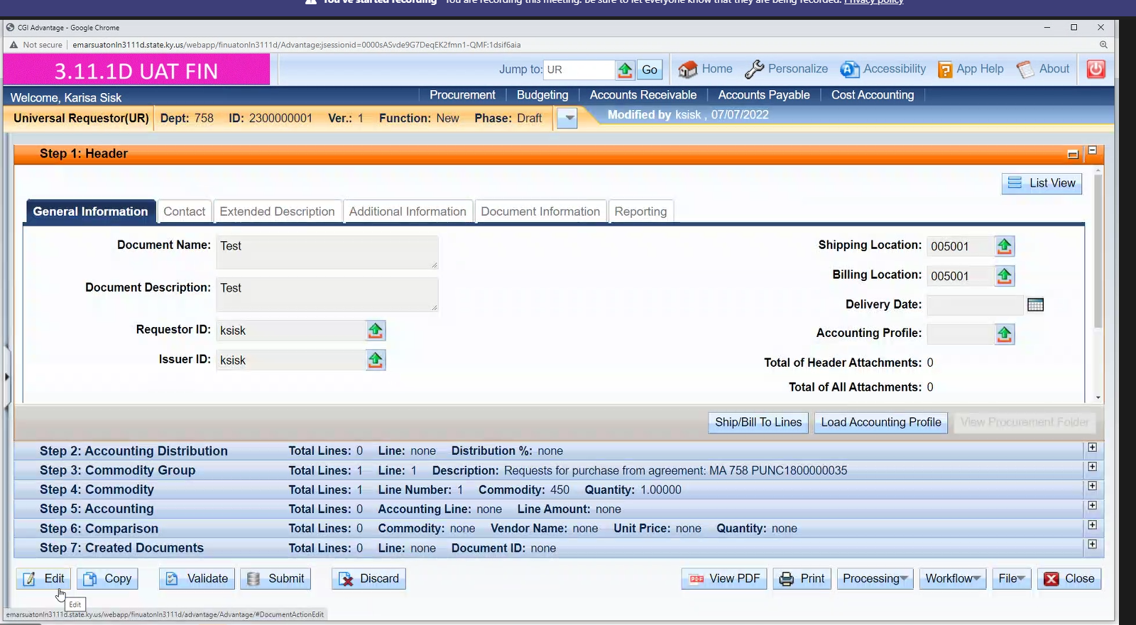
Now that you have submitted your requisition, the Universal Requisition is created
The Universal Requisition must be finalized to create your delivery order.
Your delivery order is what is submitted to vendor when finalized (DO3/DO4)
Step 17: Select the edit button at the bottom left of your screen. This is the universal requestor; please see next step on slide 17

Slide 20
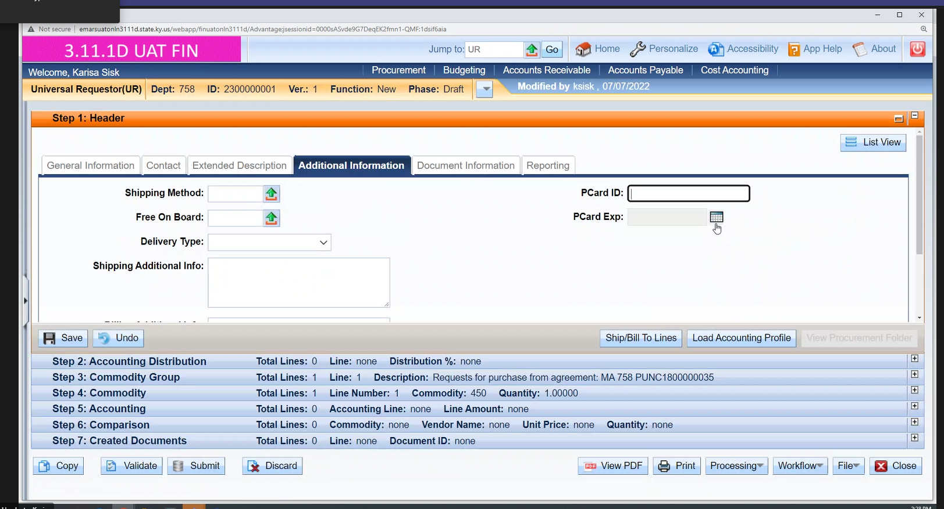
Checking out as a State of Kentucky P-Card User
After Edit, complete all required fields
Step 17: If you wish to pay by your Kentucky Pcard you would enter in your card information where the yellow arrow button is pointing

Slide 21
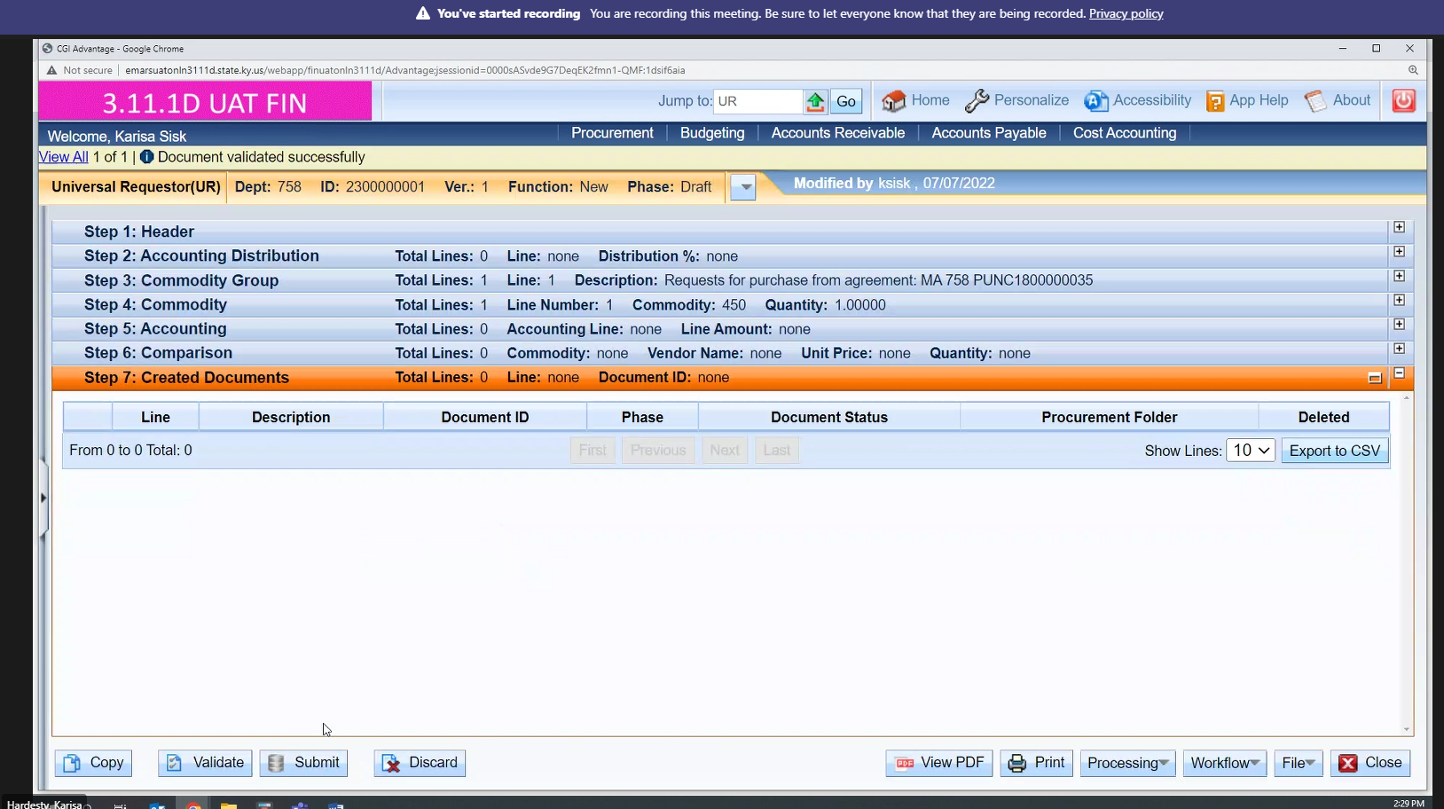
Step 18: Please validate your order and submit

Slide 22
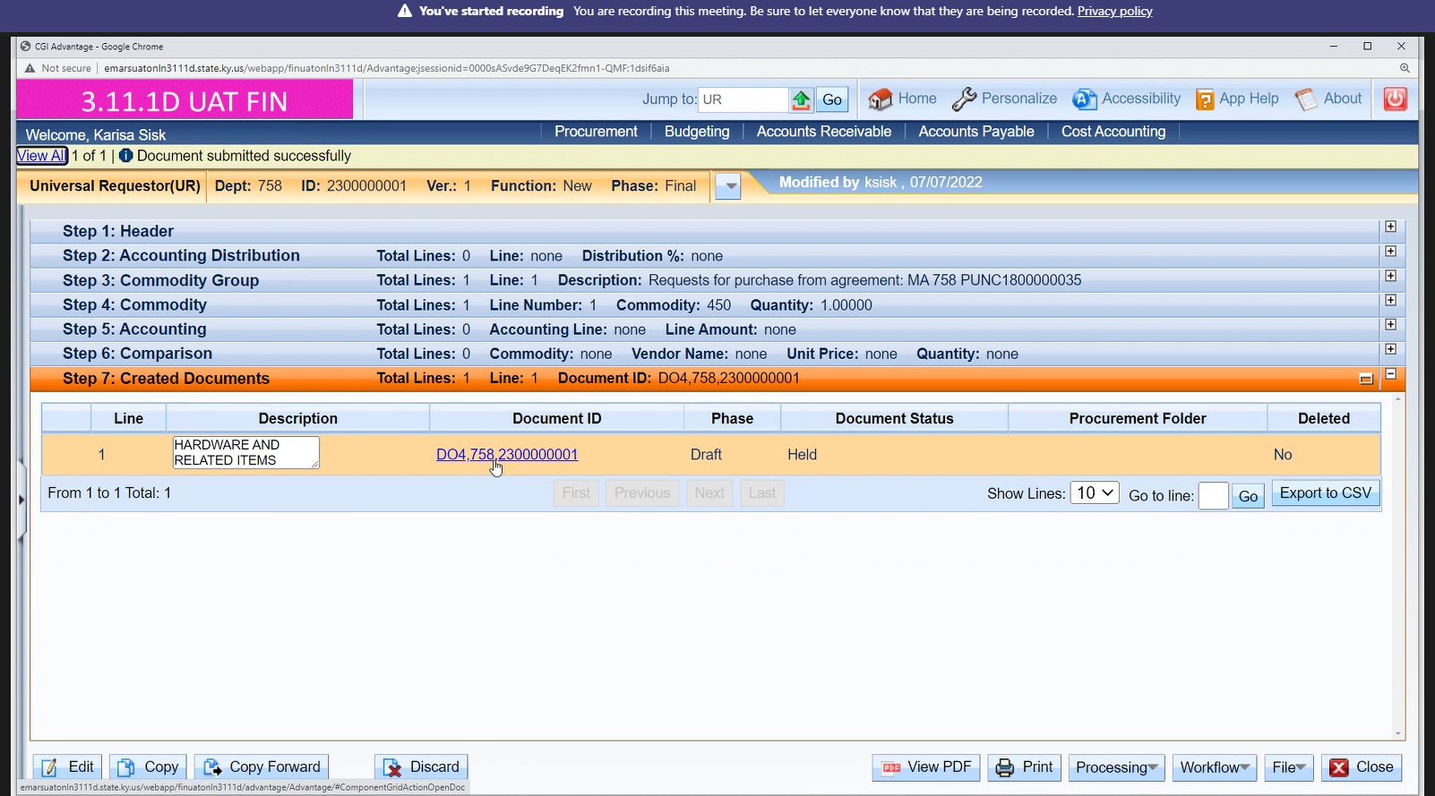
Step 19: Once you submit your order, you will see this screen with your Document ID which is your recently submitted order.
Step 20: Go and click on the Document ID number, which is your delivery order

Slide 23
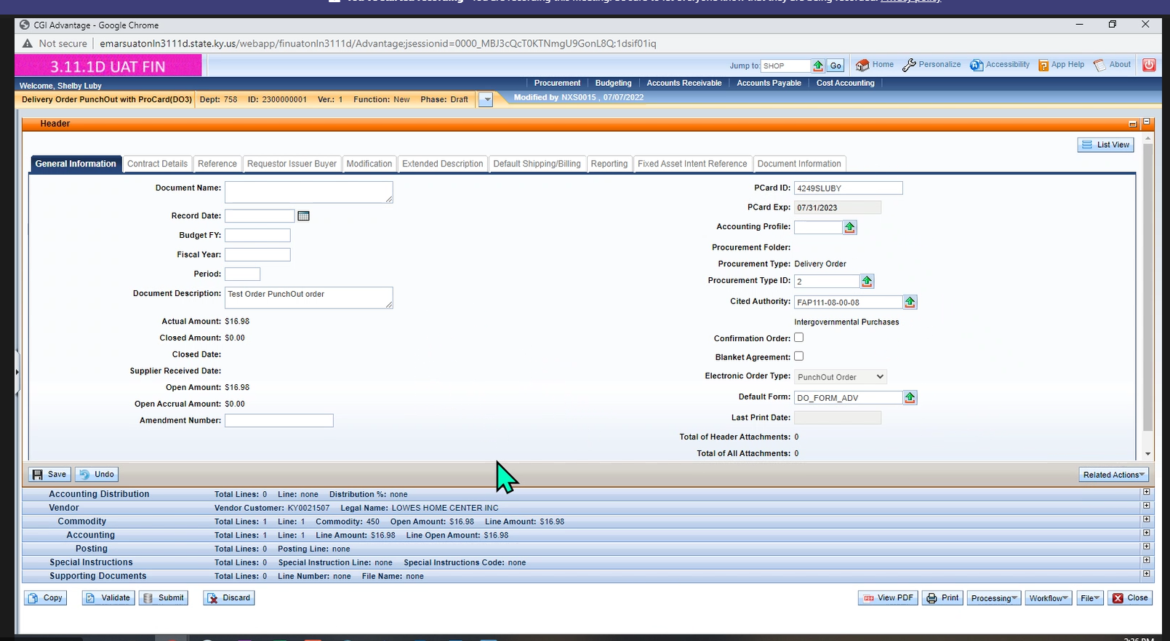
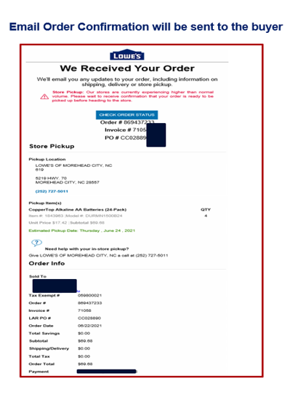
When checking out with a Kentucky PCard, you will see this screen which is the D03 at the top left
You will receive an email confirmation from Lowe’s regarding your order once submitted successfully

Slide 24
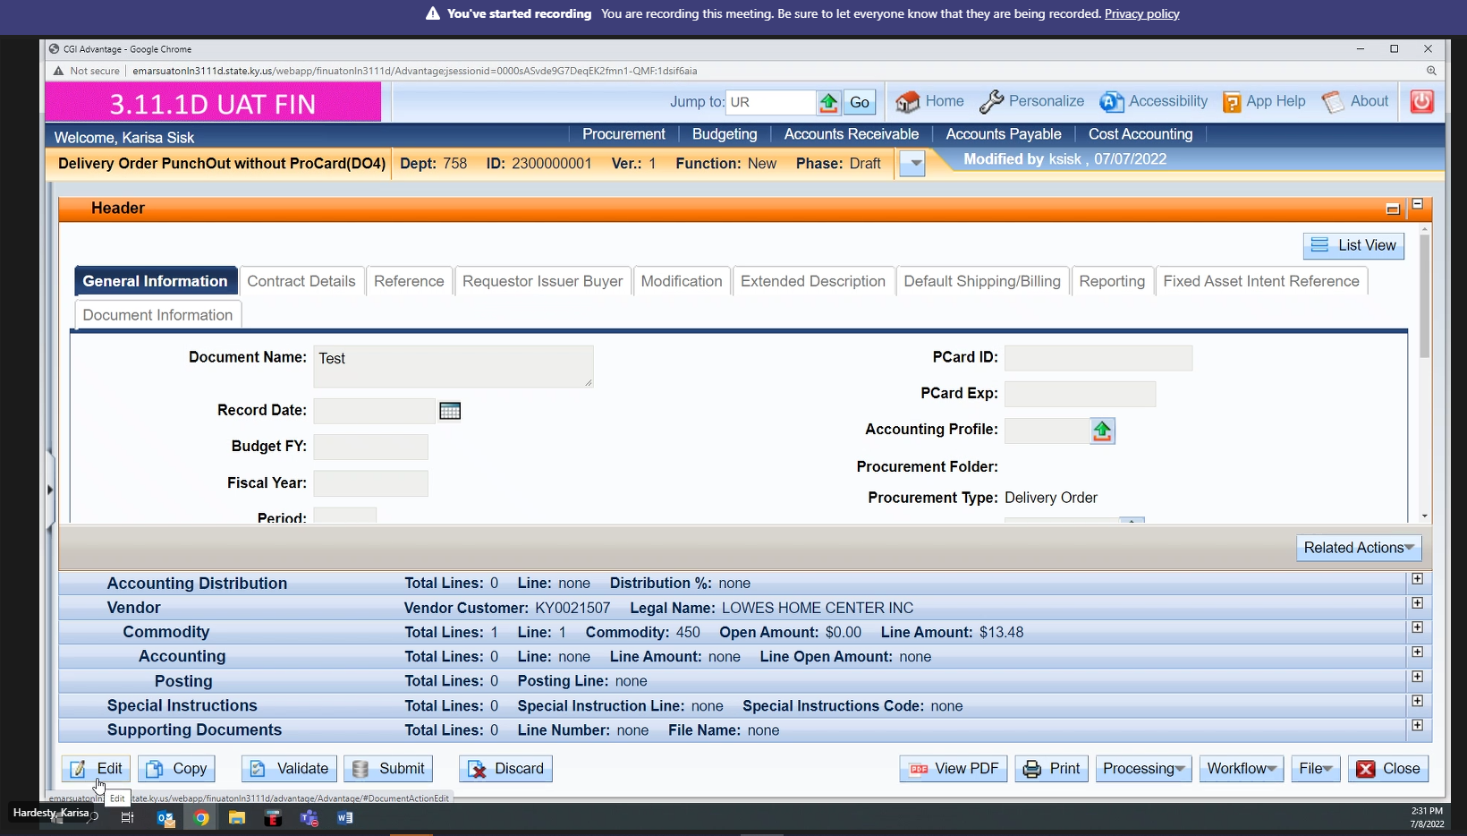
You will see D04 if you are checking out without a Kentucky Pcard. Finalization of document is required before the order is sent to the supplier

Slide 25
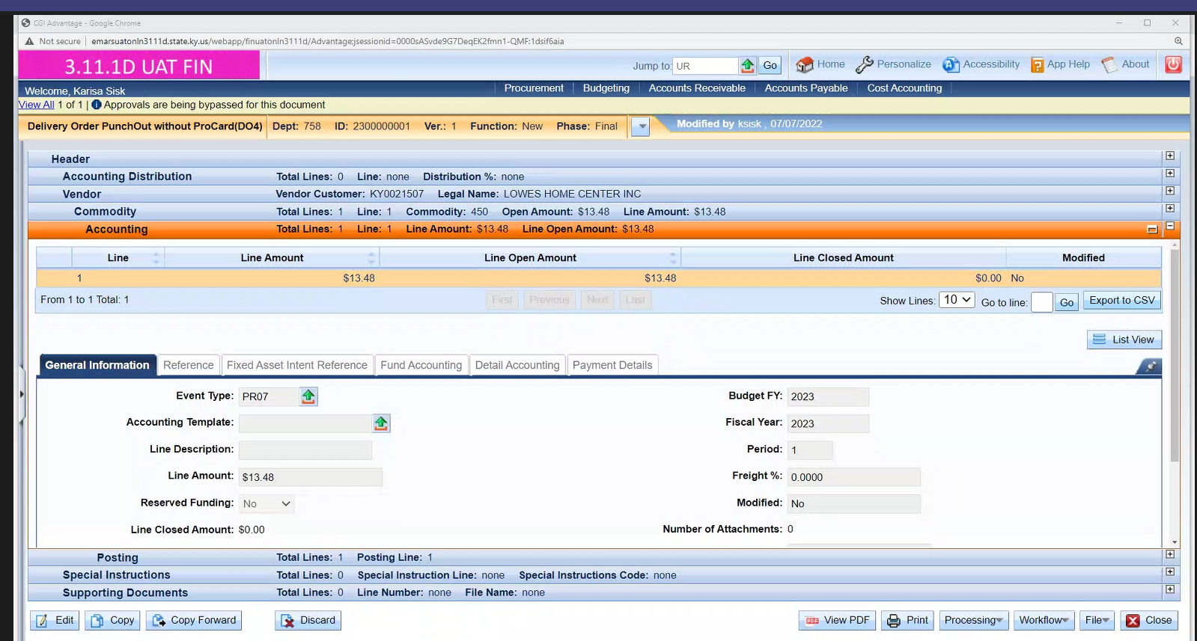
DO4s will require additional approval.
Complete your accounting information. This is required for DO3 and DO4 documents.

Slide 26
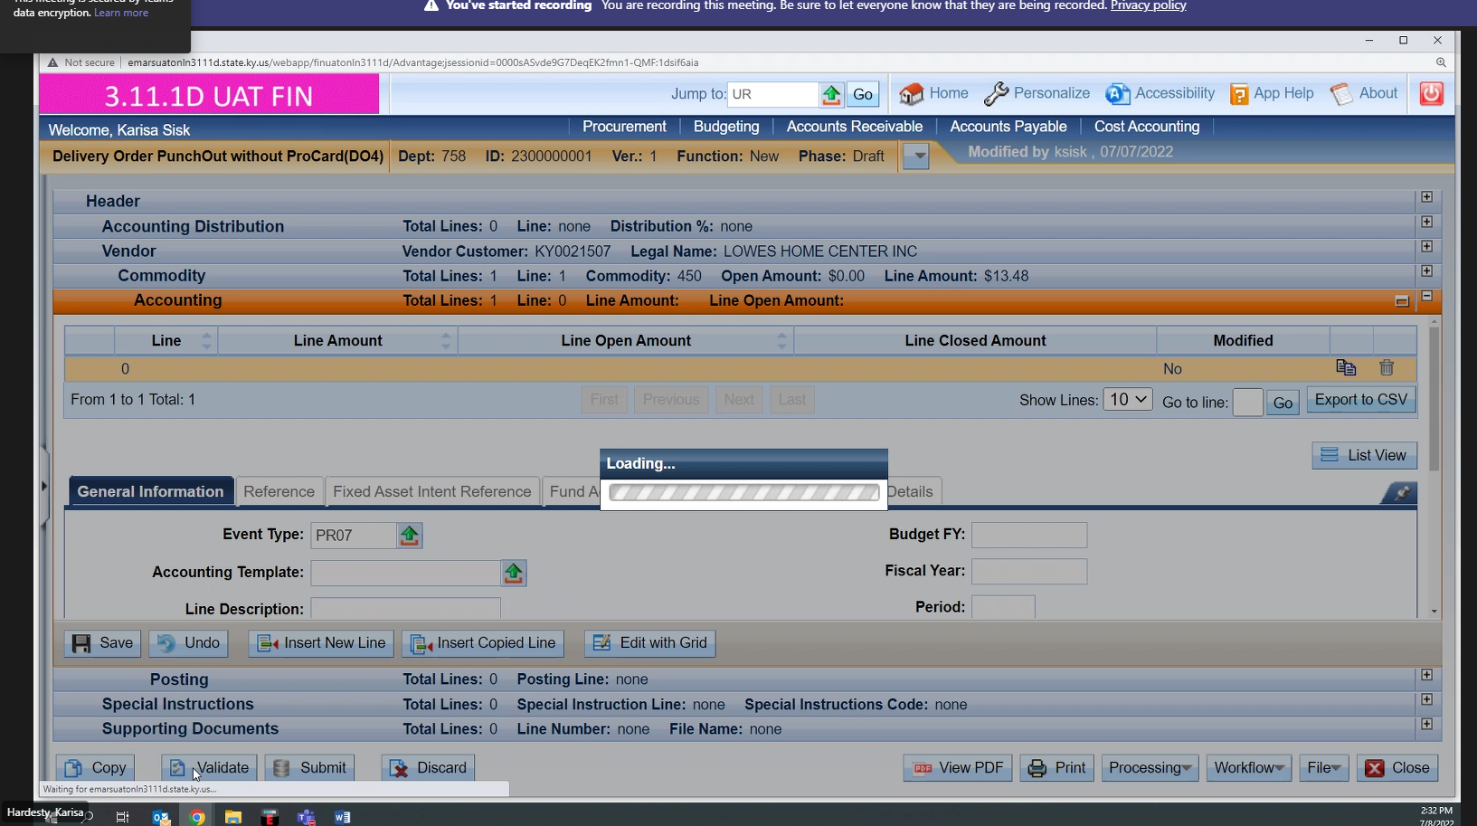
Put in your event type, check accounting information, etc. and then hit submit

Slide 27
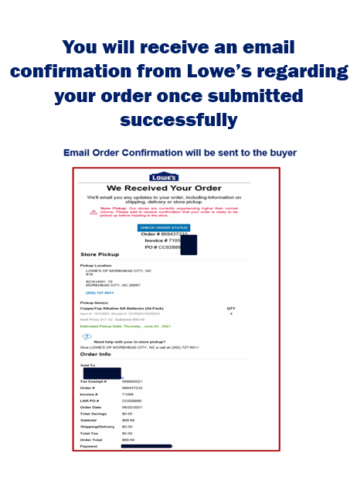
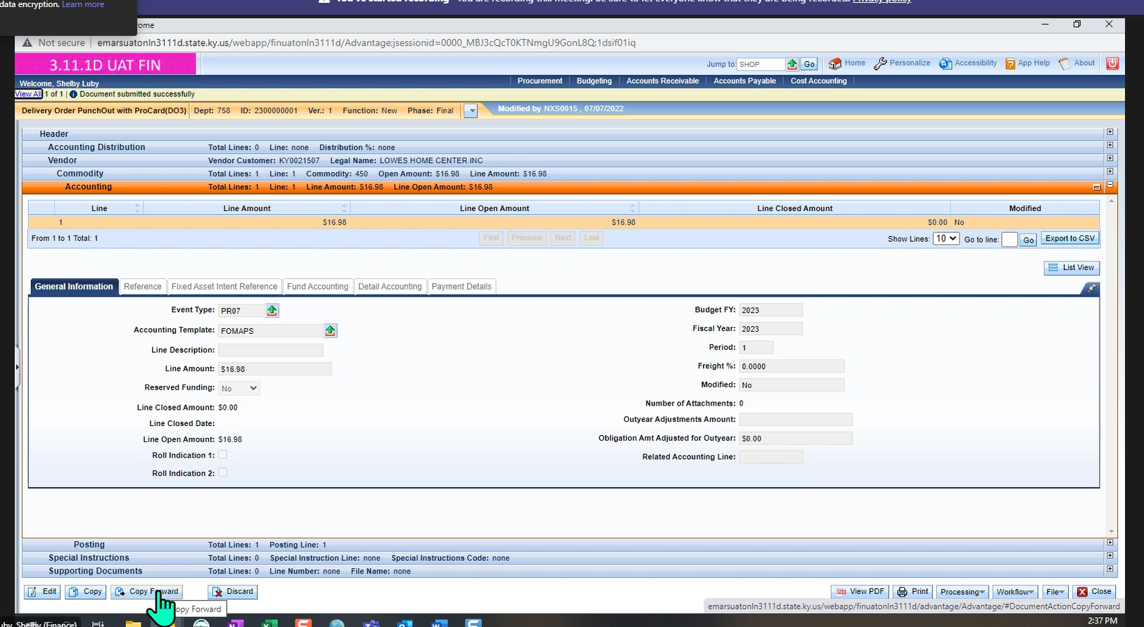
Final page when you check out with a Pcard (DO3 document), document submitted successfully to the Vendor

Slide 28
Quick Tips from LOWE’S
Review of previous information
BEFORE YOU GET STARTED
(helpful hints before you start your order)

Slide 29
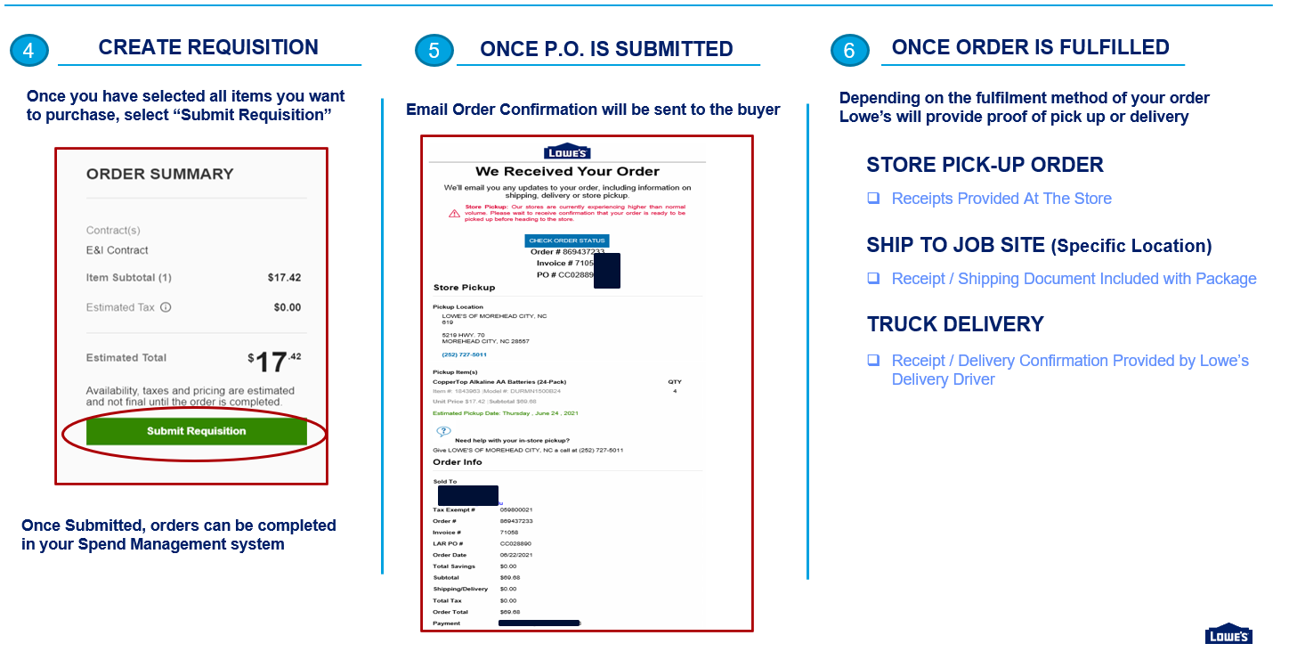
Don’t forget! Things to Know
IMPORTANT
**** Be sure that the delivery option (OR the Pick-up option) you select is the same as what you are putting into your Purchase order Process****
Ex: If you are selecting truck delivery on the website, make sure your PO says delivery as well.

Slide 30
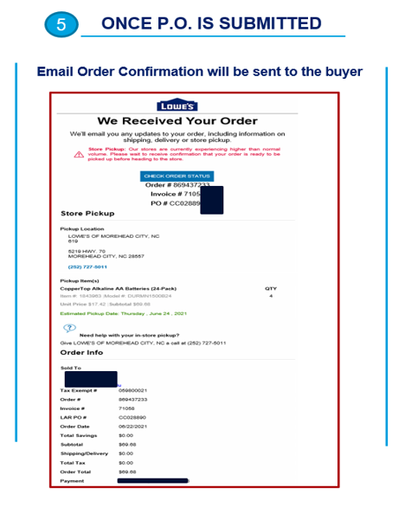
Things to Know:
How do you know if your order went through?
You will know if your order went through because you will receive a confirmation number
If you did not receive a confirmation, your order did not go through
What do you do now?
  First thing to check: Did you follow your Internal Purchase Order workflow process correctly?
    If the answer is yes, email Eprosupport@lowes.com and provide them with your purchase order number
    If the answer is no, please reach out internally to your help desk at: app@azdoa.gov

Slide 31
LOWE’S SPLASH PAGE FOR AGENCIES NOT SET UP
IMPORTANT
If you have reached this page, it means that your agency is not set up in Lowes.
Email: Governmentsupport@lowes.com with the subject “State of Arizona”
Be sure to include everything requested on the left of this page and we will get you going!

Slide 32
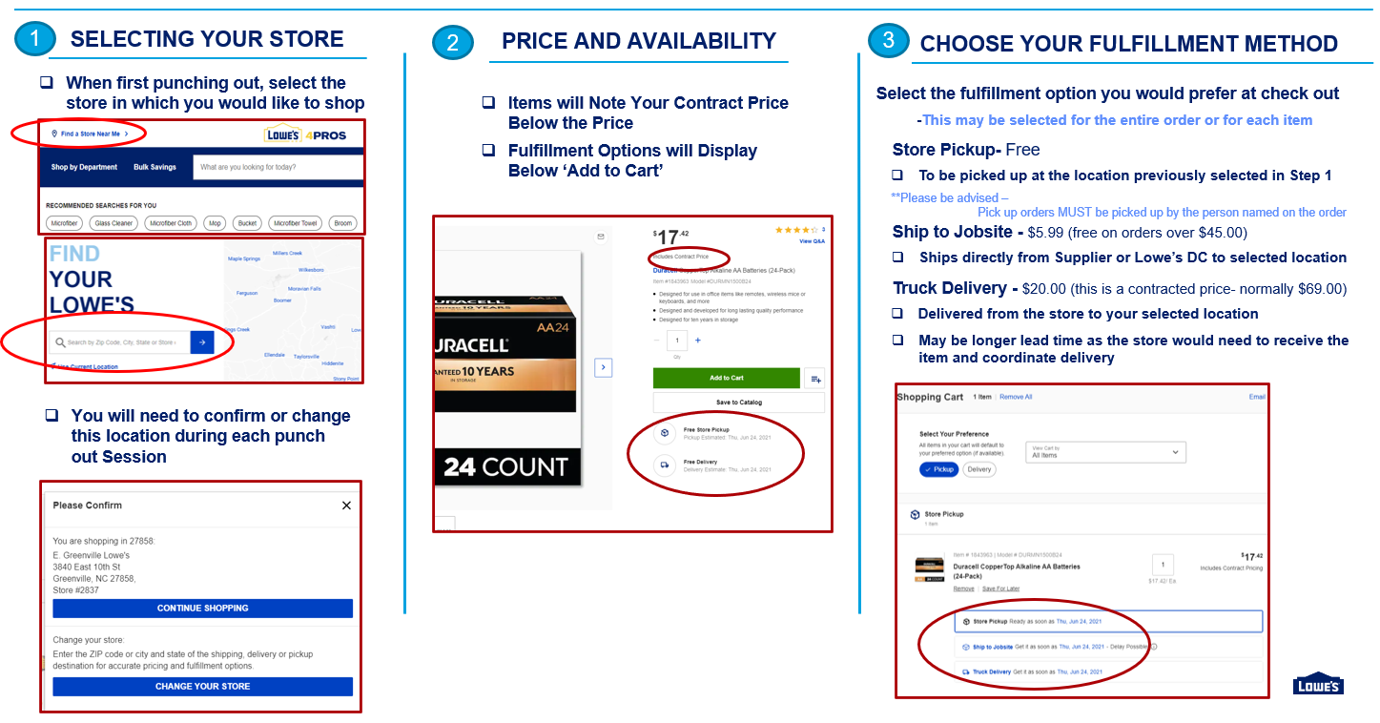
STEP 1, 2, AND 3- THINGS TO KNOW

Slide 33
STEPS 4, 5, AND 6- Things to Know
IMPORTANT
**** Be sure that the delivery option (OR the Pick-up option) you select is the same as what you are putting into your Purchase order Process****
Ex: If you are selecting truck delivery on the website, make sure your PO says delivery as well.

Slide 34
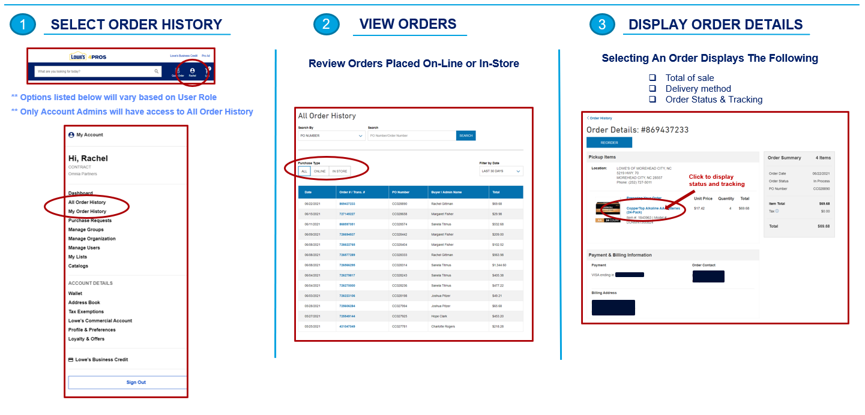
LOWES PUNCH-OUT – ORDER HISTORY & TRACKING

Slide 35
THE POWER OF PARTNERSHIP
©2022 Lowe’s. LOWE’S, the Gable Mansard Design and Lowe’s Pro Supply are trademarks or registered trademarks of LF, LLC.
3463334-0110-03

